Slide 1

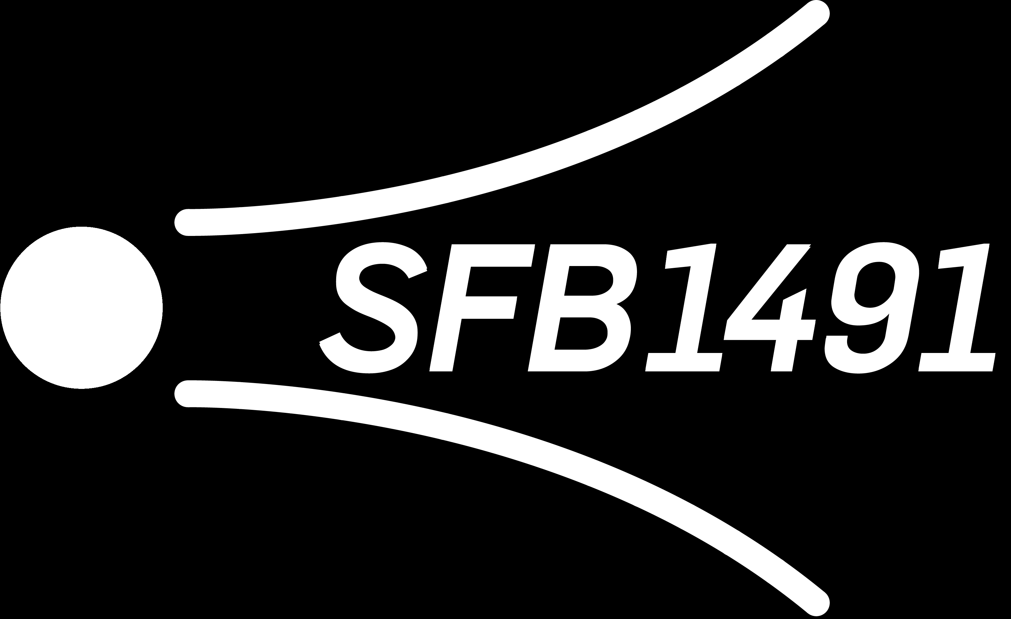
From IceCube to Sky: A Deep Dive into Prompt Muon Mysteries Pascal Gutjahr
September 17, 2024
Source: NASA

Slide 2
-- General aspects --
where and how shall I define my motivation?
focus only on prompt muons? also neutrinos?
muon puzzle? – I can also add slides from backup to motivation to explain that the pion-kaon ratio is important
combined fit with neutrinos is planned
understanding the cosmic ray flux
address questions mentioned by dennis in his review

Slide 3
To-Do list
re-create/update level3 bundle energy at surface plots (pre-cut) → processing jobs with muon filter and dnn reconstructions
check/run unfolding with systematics
create a plot that verifies our lower simulation bound of 10 TeV

Slide 4
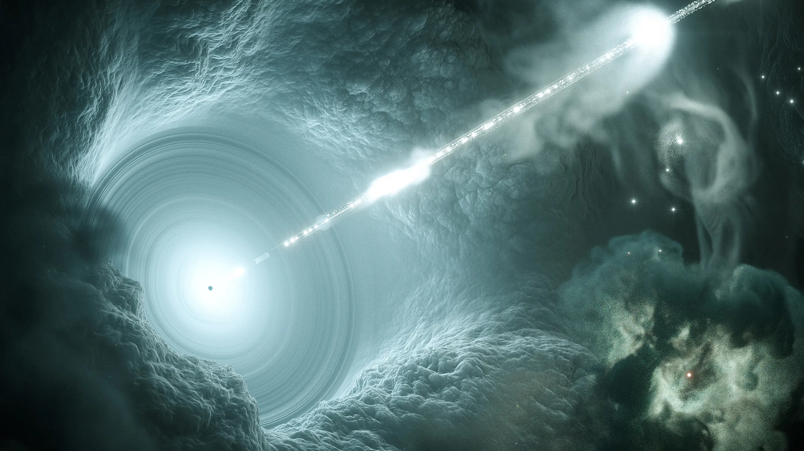

Slide 5

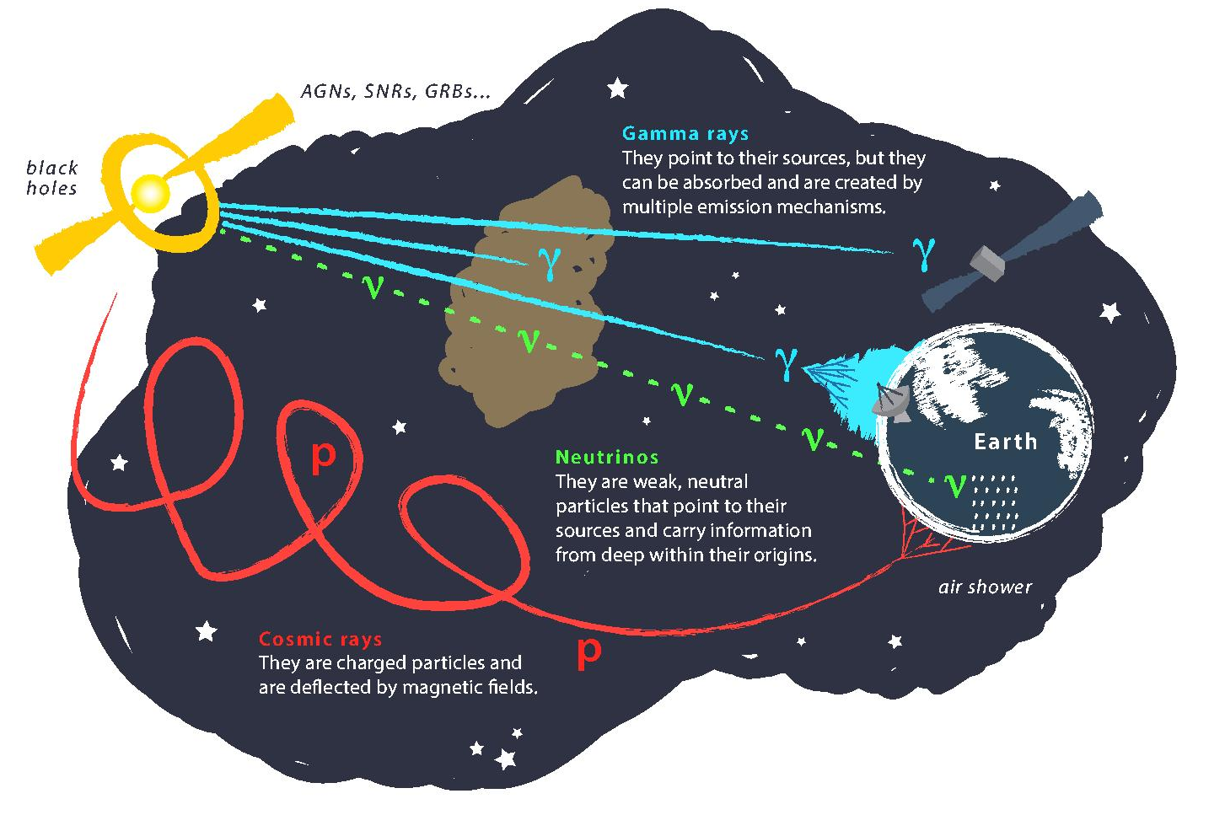
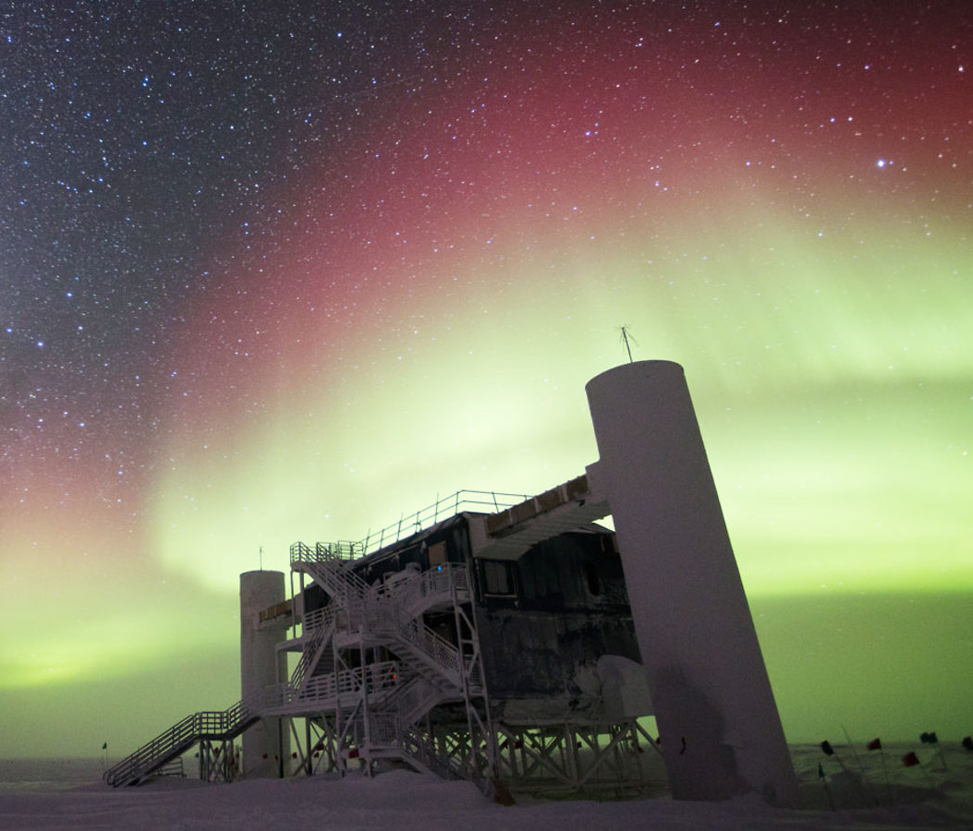
Astroparticle physics
gallery.icecube.wisc.edu
Credit: IceCube / NSF

Slide 6
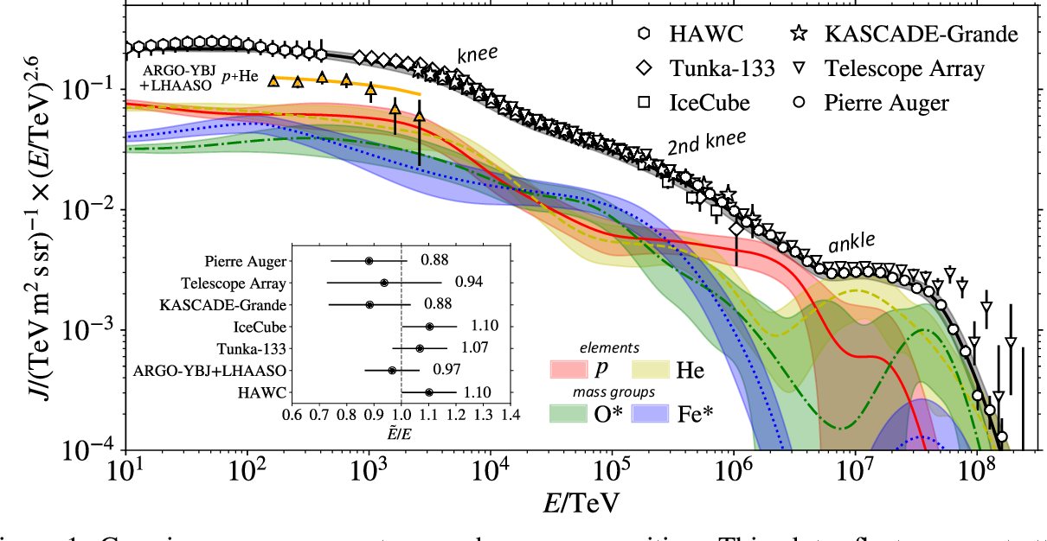
Cosmic ray flux
1903.07713

Slide 7
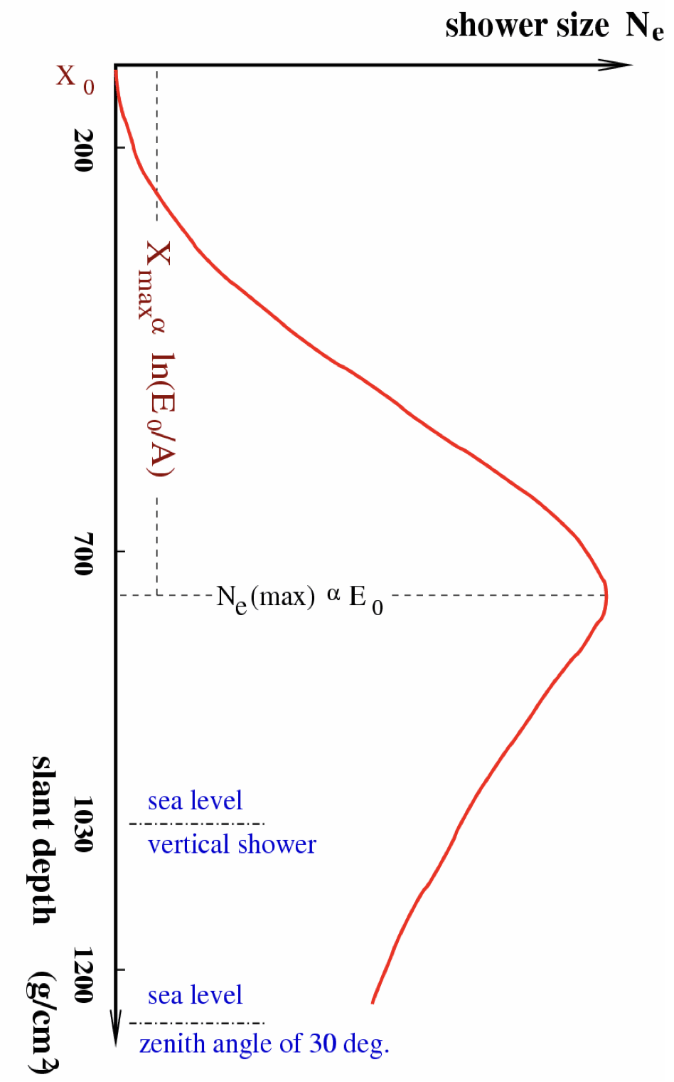
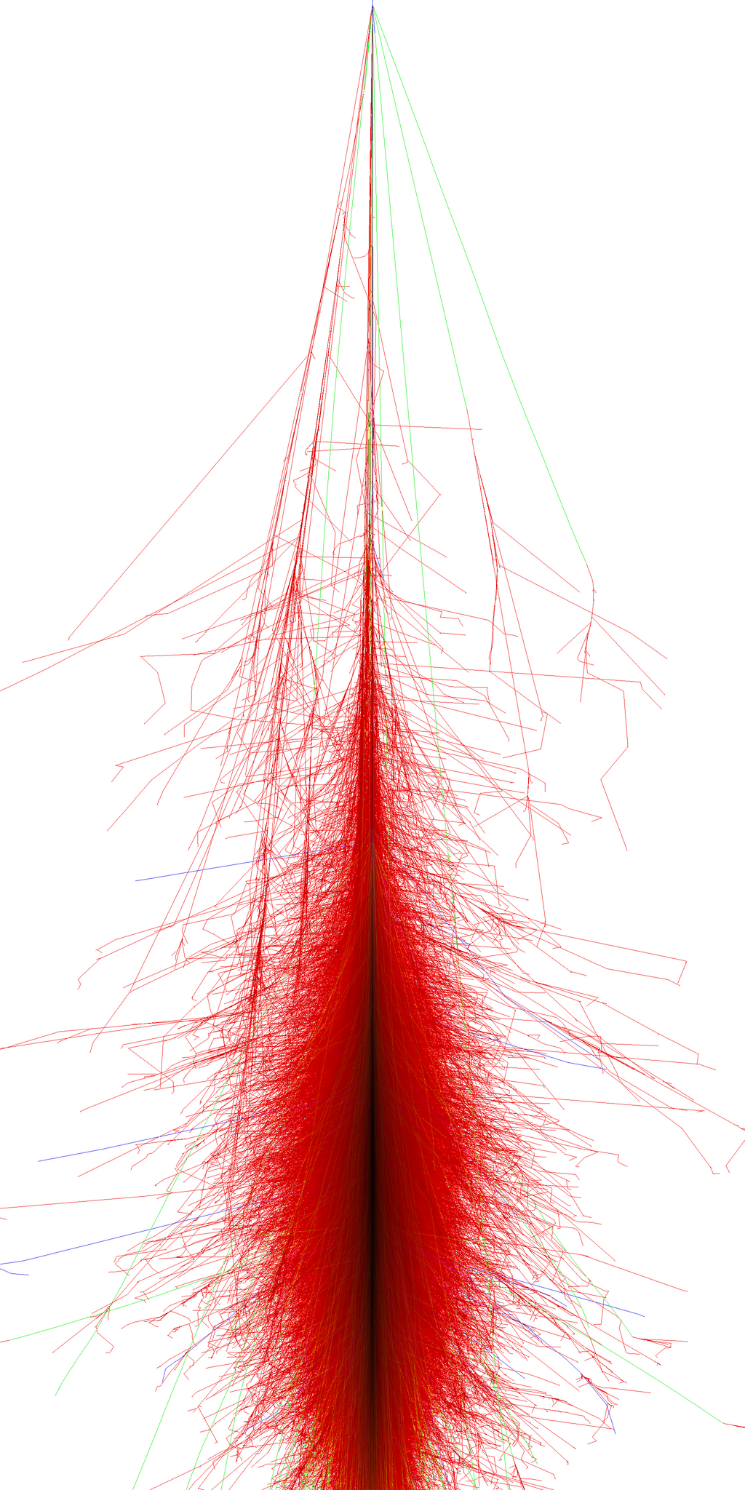
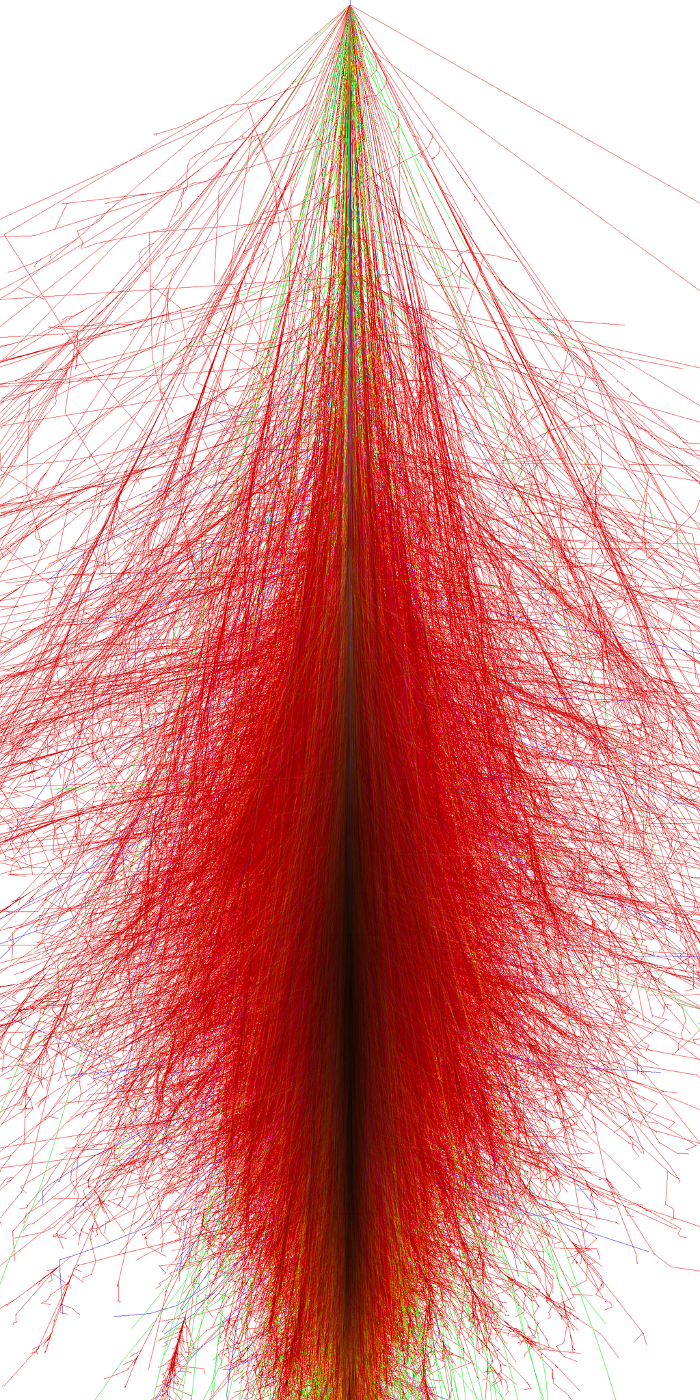
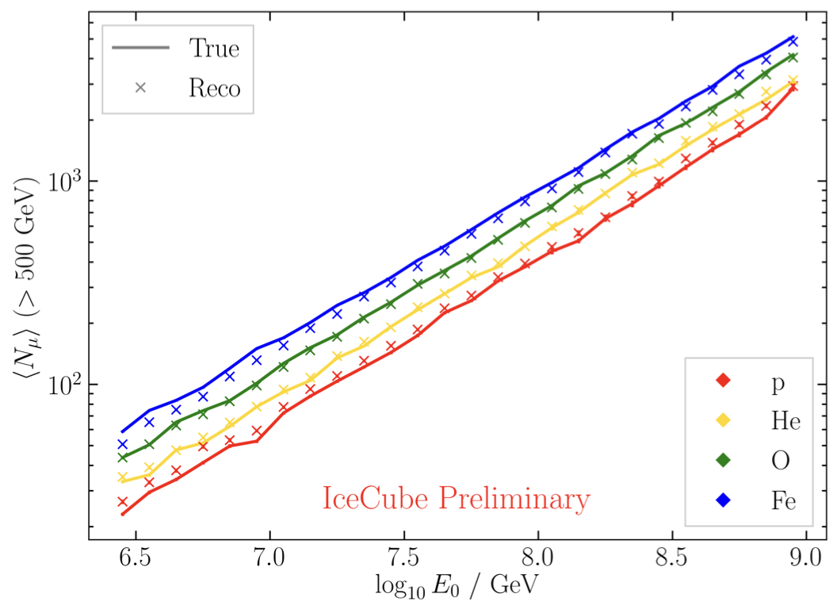
Air shower – 10 TeV
“muon bundles”
zeuthen.desy.de
Ralph Engel 2005
2211.16970v2
Proton
Iron

Slide 8

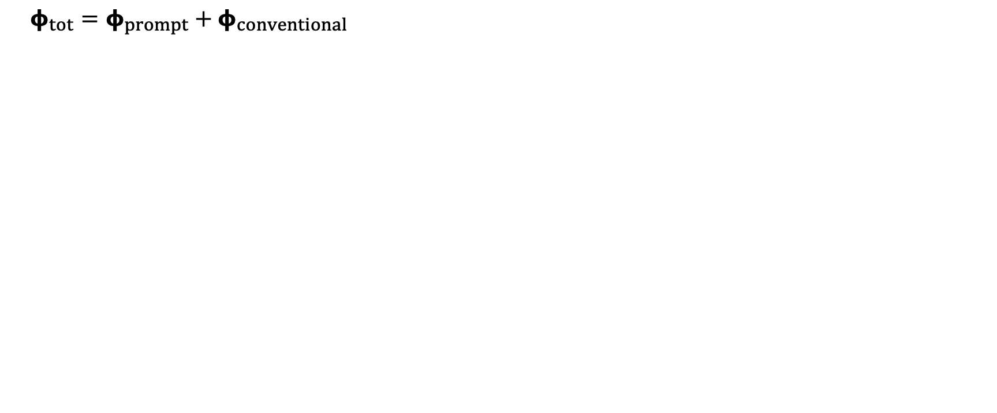
Muon flux
$φ_{tot}=φ_{prompt}+$ $φ_{conventional}$
Credit: Ludwig Neste

Slide 9
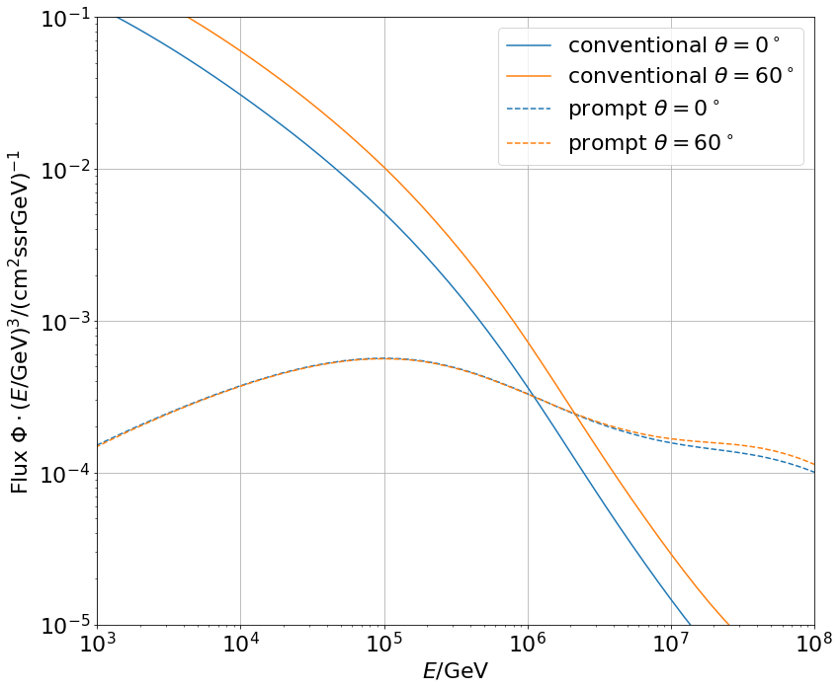
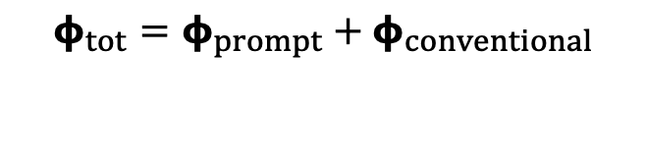
Muon flux: Prompt spectrum
$φ_{tot}=φ_{prompt}+$ $φ_{conventional}$
0°: perpendicular to Earth’s surface
Most energetic muon in bundle
conventional
prompt
Muon parent:
pion or kaon
yes
no
conventional
prompt

Slide 10
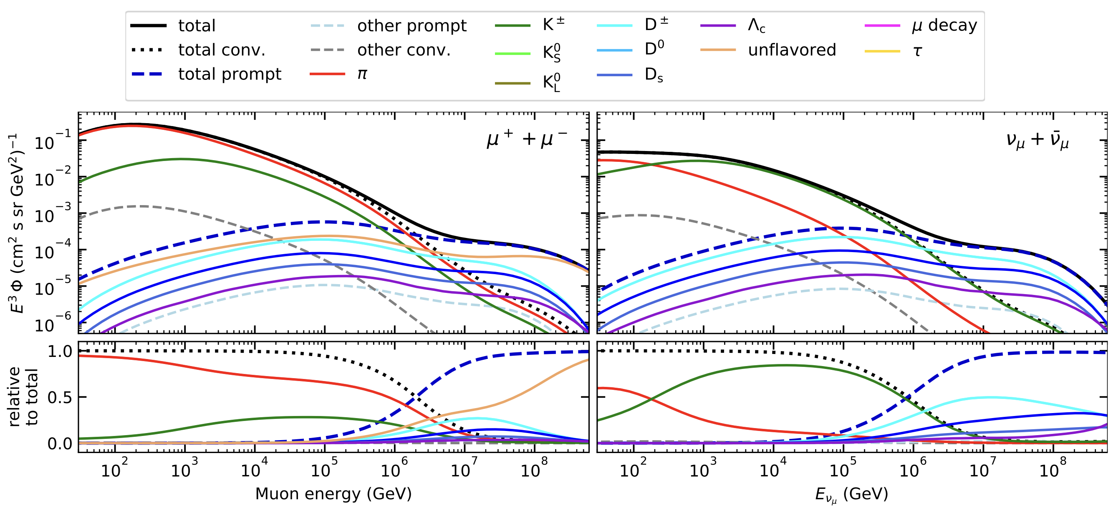
Prompt atmospheric muons and neutrinos
10.1103/PhysRevD.100.103018
no unflavored
dominated by pions
dominated by kaons
Combined fit:
handle on pion/kaon ratio
handle on charmed mesons

Slide 11
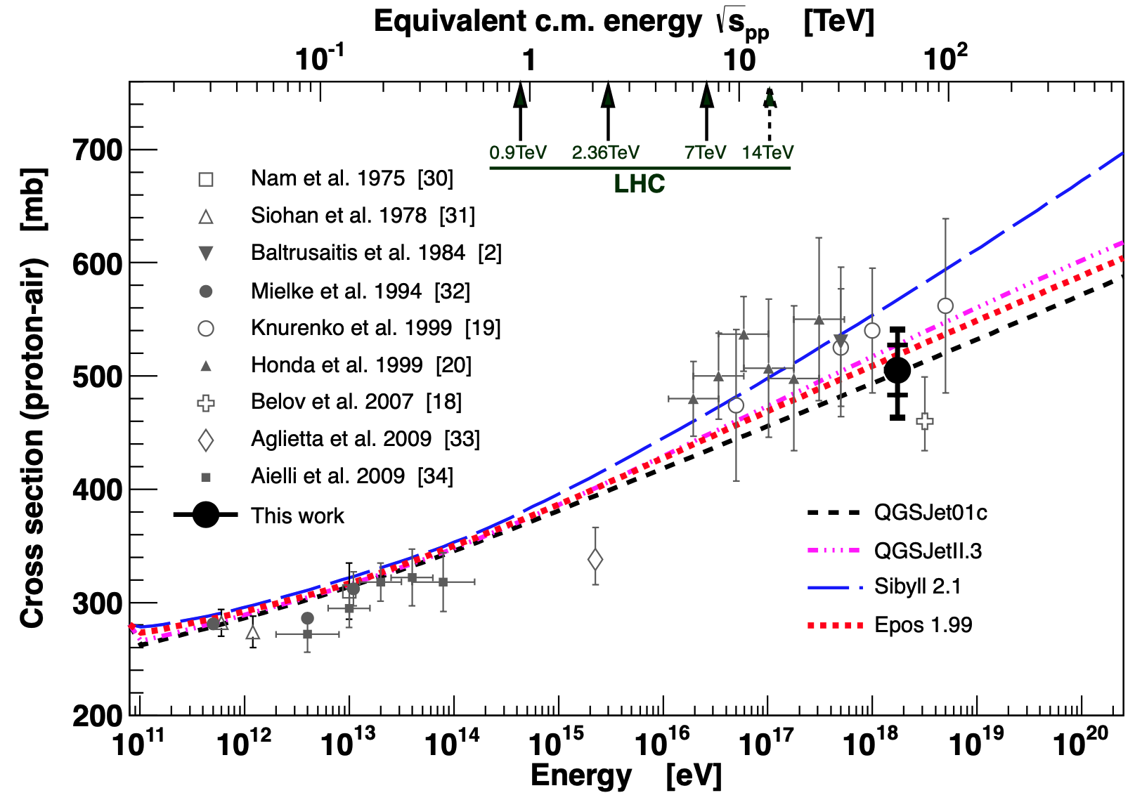
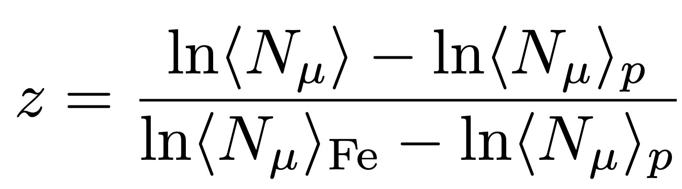
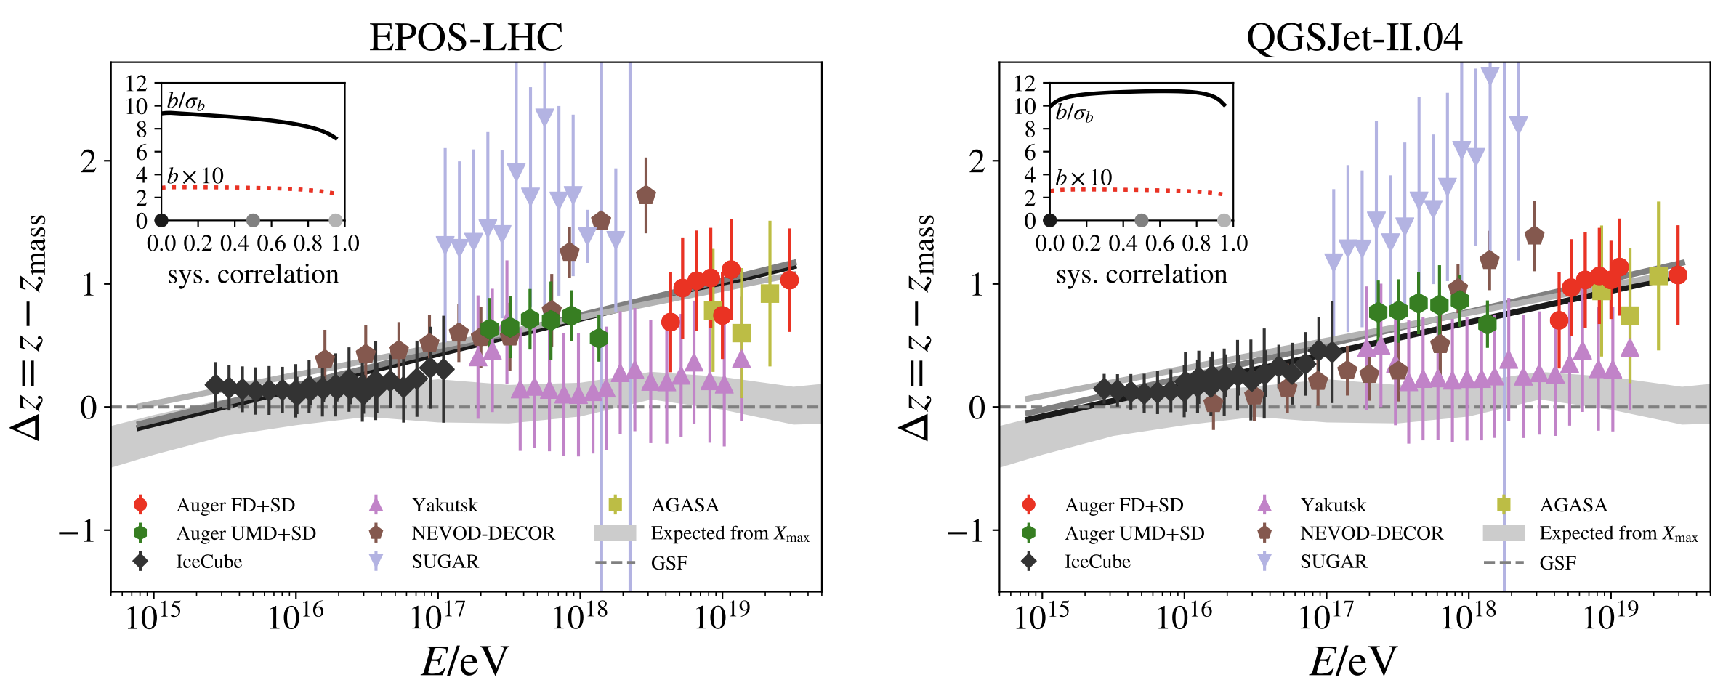
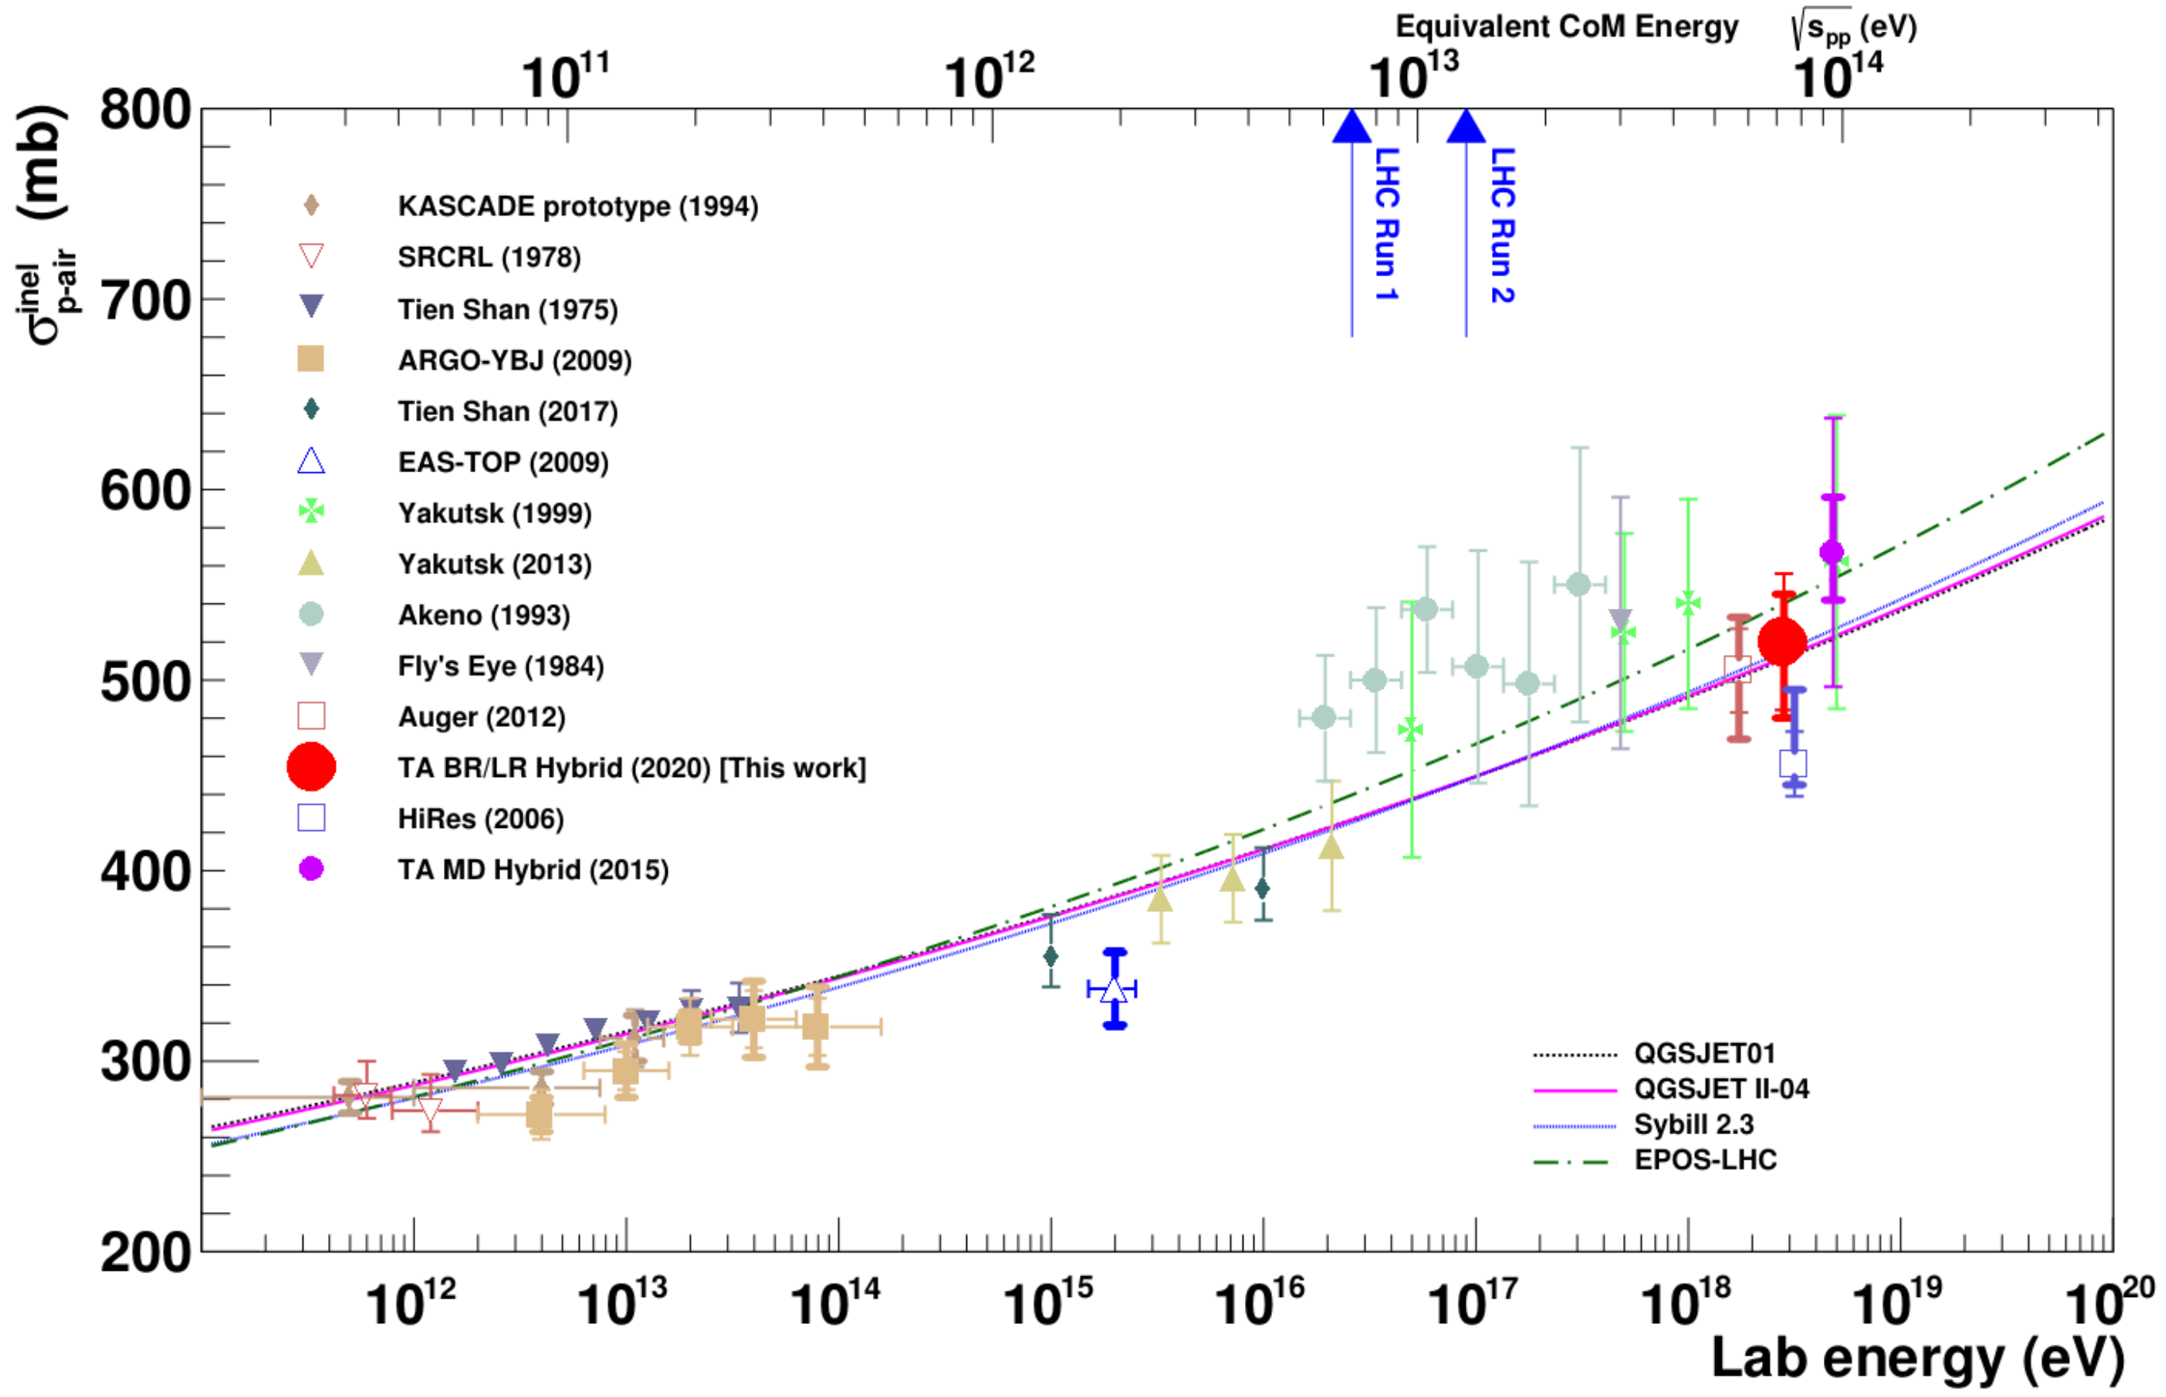
Muon puzzle and model uncertainties
”muon number”
Expected z
(“muon number)
2012
2108.08341
1208.1520
Uncertainties at E > 10 PeV
2020
More muons measured than simulated for E > 40 PeV ~ cms 8 TeV
2006.05012

Slide 12
Analysis goals
Detect prompt component of the atmospheric muon flux
Measure the normalization
Get handle on hadronic interaction models
Unfold a muon energy spectrum
Idea:
New CORSIKA simulations with extended history
Tag muons by parent → prompt or conventional
Scale amount of prompt particles
Scaling saves time and resources instead of doing multiple simulations with different interaction models
Perform forward fit of the prompt normalization
Future:
Measure prompt neutrinos
Combined muon and neutrino fit

Slide 13
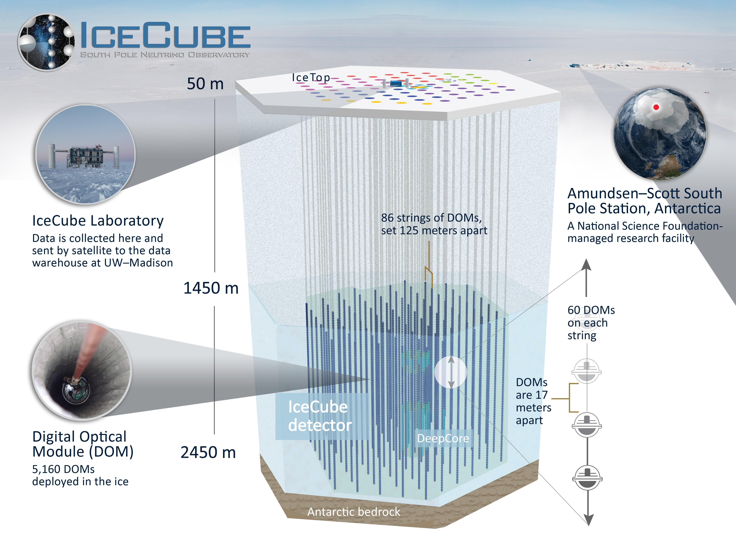

Slide 14
Overview
Analysis
Simulation
Reconstruction
Selection
Forward fit
Dataset
CORSIKA 77500 Ehist
SIBYLL 2.3d
10 TeV – 100 EeV
DNN reconstructions
Muon energies
Muon direction
Track geometry
Level 3
L2 muon filter
500 TeV bundle energy cut at surface
Add labels
Fit prompt normalization
Poisson LLH fit
Validation
Tag prompt / conv particles
MCEq comparisons
Unfolding
Level 4
Add DNN reconstructions
Muon spectrum
Unfold muon flux
Level 5
Data-MC quality cuts

Slide 15
New CORSIKA simulation
with extended history option for information about the parent particles

Slide 16
CORSIKA 7 tagging and MCEq comparison
MCEq: tool to numerically solve the cascade equations that describes the evolution of particle densities as they propagate through a gaseous, dense medium
https://github.com/mceq-project/MCEq
GSF weighting
GSF weighting
Good agreement in total prompt and conv muon flux
D⁰ and D_{s} are swapped here but this is fixed in MCEq

Slide 17
Agreement for different primary models

Slide 18
DNN reconstructions

Slide 19
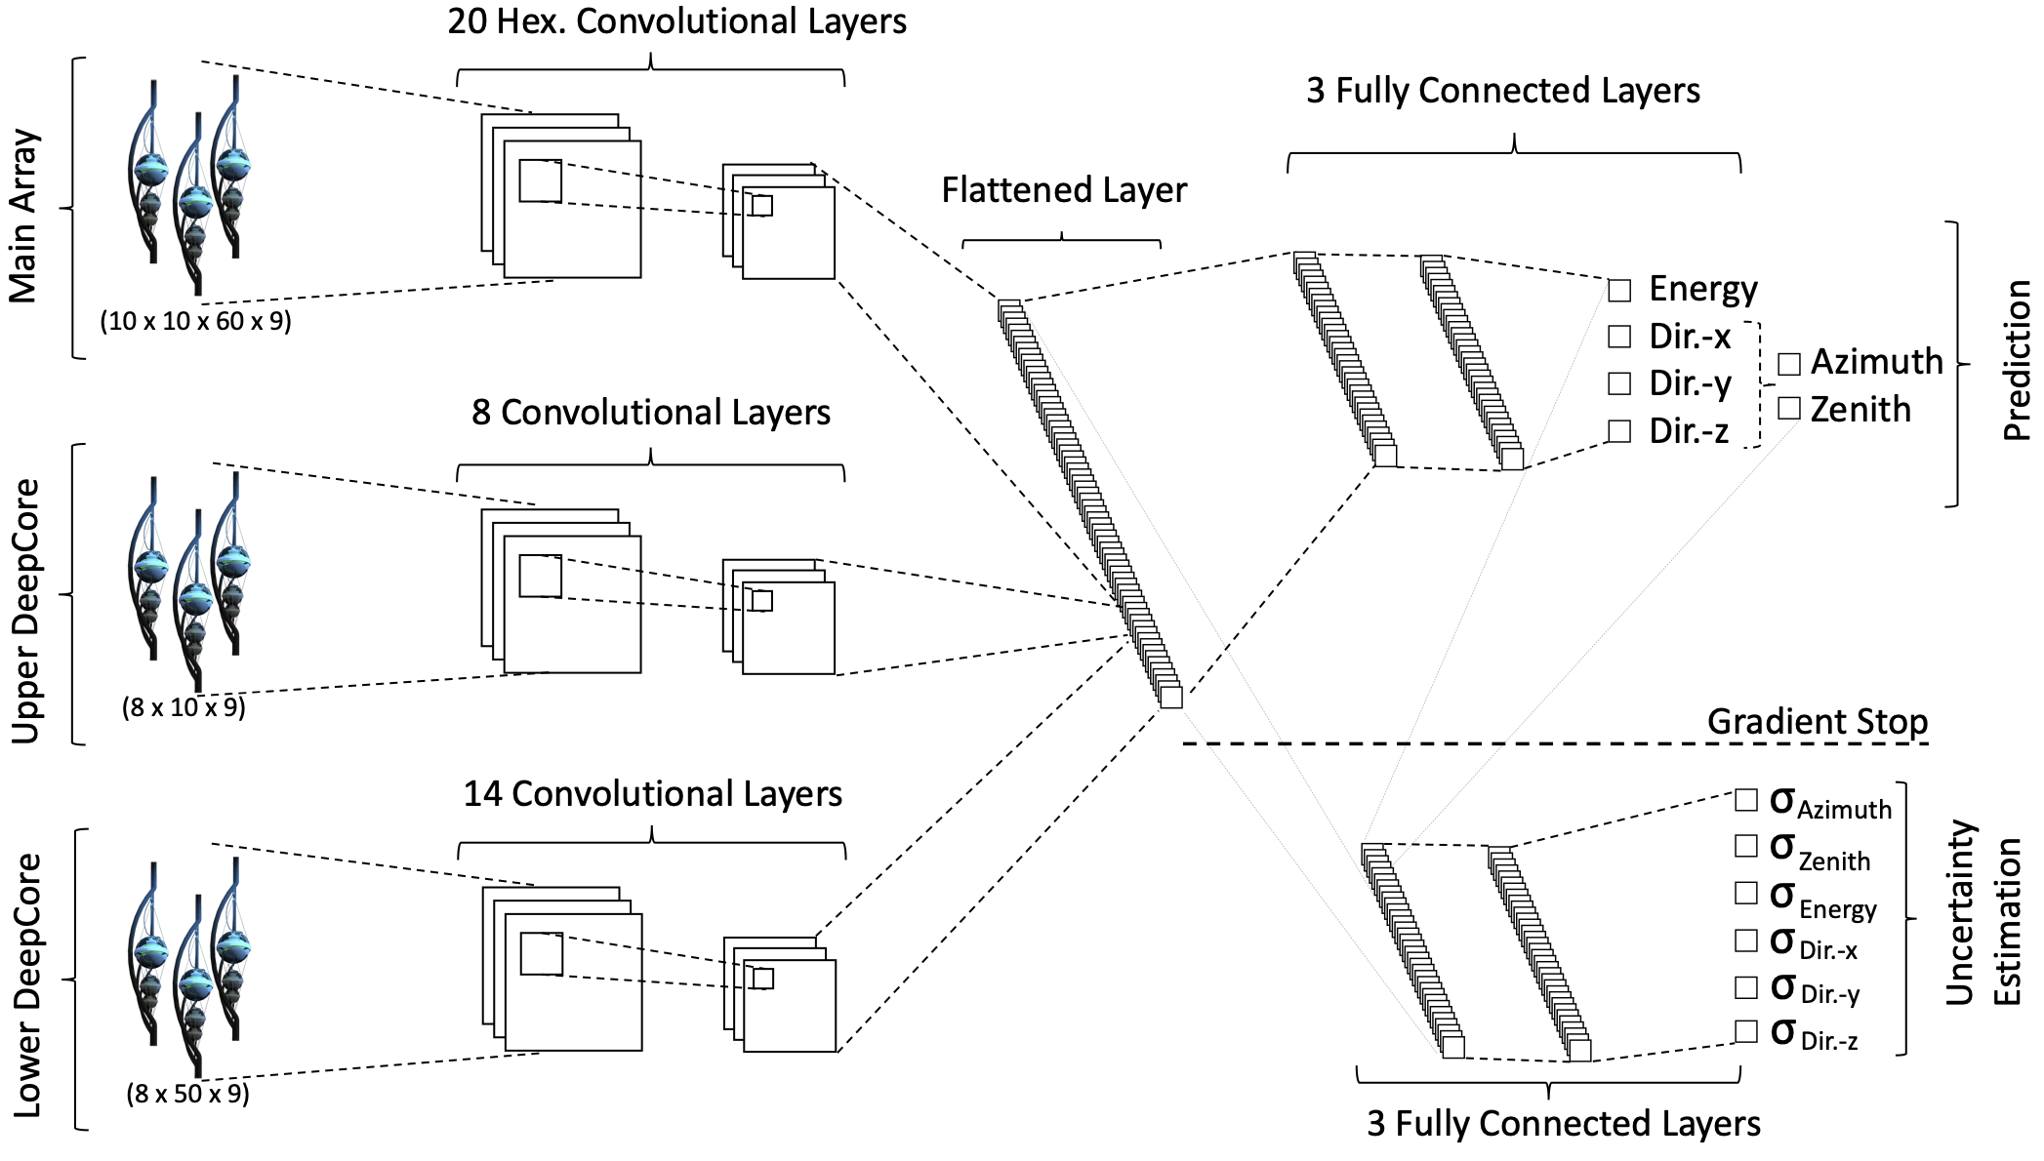
Convolutional Neural Network (CNN)
fast
identifying spatial patterns
better event reconstruction and classification
2101.11589

Slide 20
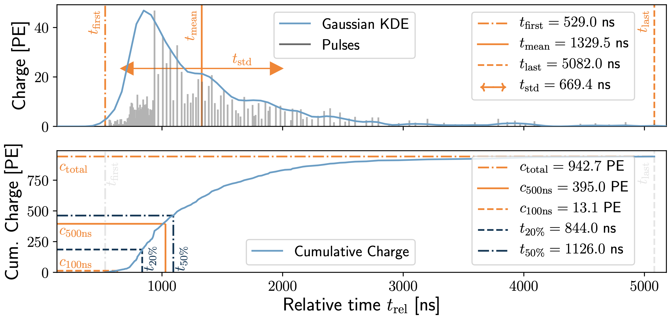
Input data per DOM
10.1088/1748-0221/16/07/P07041
3 inputs
c_{total}: Total charge
Sum of charge
t_{first}: Relative time of first pulse
Relative to total time offset, calculated as the charge weighted mean time of all pulses
t_{std}: Standard deviation of first pulse
Charge weighted standard deviation of pulse times relative to total time offset
9 inputs
t_{last}: Relative time of last pulse
Relative to total time offset, calculated as the charge weighted mean time of all pulses
t_{20%}: Relative time of 20% charge
Relative to total time offset, calculated as the charge weighted mean time of all pulses
t_{50%}: Relative time of 50% charge
Relative to total time offset, calculated as the charge weighted mean time of all pulses
t_{mean}: Mean time
Charge weighted mean time of all pulses relative to total time offset
c_{500ns}: Charge at 500ns
Sum of charge after 500ns
c_{100ns}: Charge at 100ns
Sum of charge after 100ns
Input pulses
SplitInIceDSTPulses
SplitInIceDSTPulsesTWCleaning6000ns
(DNN framework performs an internal cleaning)
Training datasets
20904
21962
22020
22187

Slide 21
Reconstructed properties
Energy
entry_energy: Leading muon energy at the detector entry
bundle_energy_at_entry: Muon bundle energy at the detector entry
muon_energy_first_mctree: Leading muon energy at surface
bundle_energy_in_mctree: Muon bundle energy at surface
Track geometry
Length: Propagation length of muon in the ice
LengthInDetector: Propagation length of muon in the detector
center_pos_x: Closest x position of muon to center of the detector
center_pos_y: Closest y position of muon to center of the detector
center_pos_z: Closest z position of muon to center of the detector
center_pos_t: Time of closest approach to the center of the detector
entry_pos_x: x position of muon at the detector entry
entry_pos_y: y position of muon at the detector entry
entry_pos_z: z position of muon at the detector entry
entry_pos_t: Time of muon at the detector entry
Direction
zenith: Zenith angle of muon
azimuth: Azimuth angle of muon
Network 1
Network 0: Muon bundle energy at surface (fast pre-cut)
Network 2
Network 3

Slide 22
Bundle energy at entry – 6 ms cleaned pulses
Median + 90% quantile
Prediction
True

Slide 23
Leading muon energy at entry – 6 ms cleaned pulses
Median + 90% quantile
Prediction
True

Slide 24
Bundle energy at surface – 6 ms cleaned pulses
Median + 90% quantile
Prediction
True

Slide 25
Leading muon energy at surface – 6 ms cleaned pulses
Median + 90% quantile
Prediction
True

Slide 26
Angular reconstructions: DNN vs. SplineMPE
DNN contours
DNN: ~6ms
Only small improvement at energies around 1 PeV
Countours are larger
Additional runtime
-> Use only DNN reconstruction, since we do not need the best angular resolution

Slide 27
Selection

Slide 28
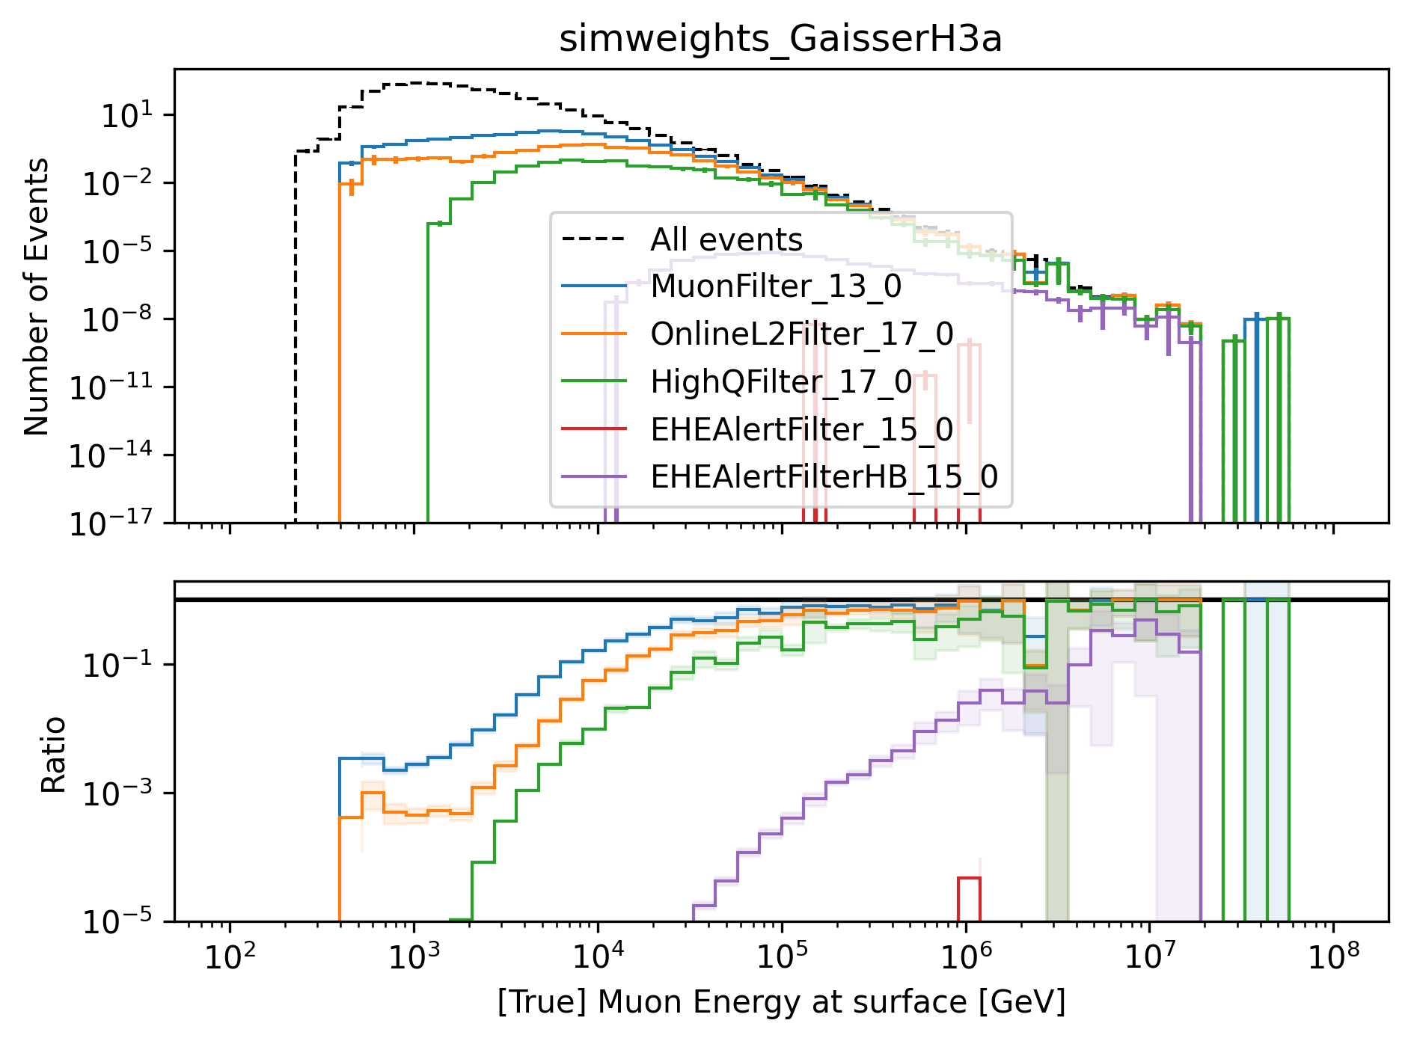
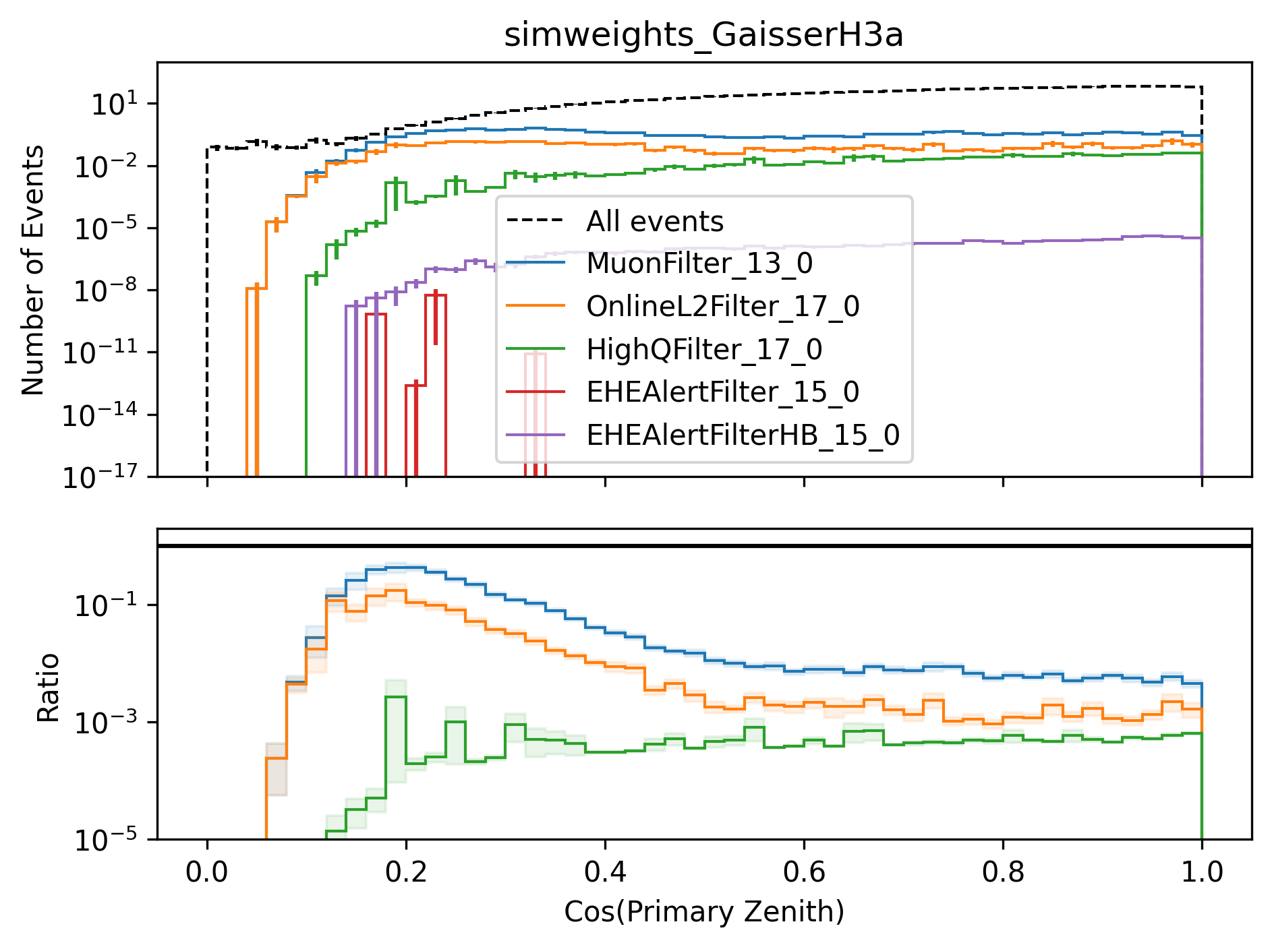
level3: muon filter
HighQFilter: removes more horizontal events → muons travel large distances, not enough energy left to pass high-charge filter
Goal: keep AMAP high-energy events at surface → muon filter

Slide 29
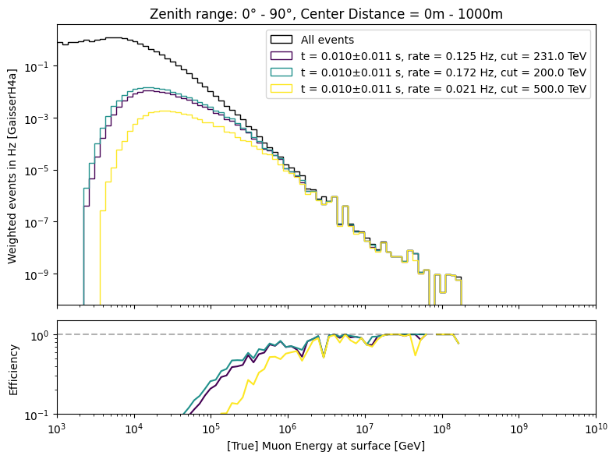
level3: 500 TeV bundle cut at surface

Slide 30
level4: add dnn reconstructions
Network 1: Energy
Network 2: Track geometry
Network 3: Direction

Slide 31
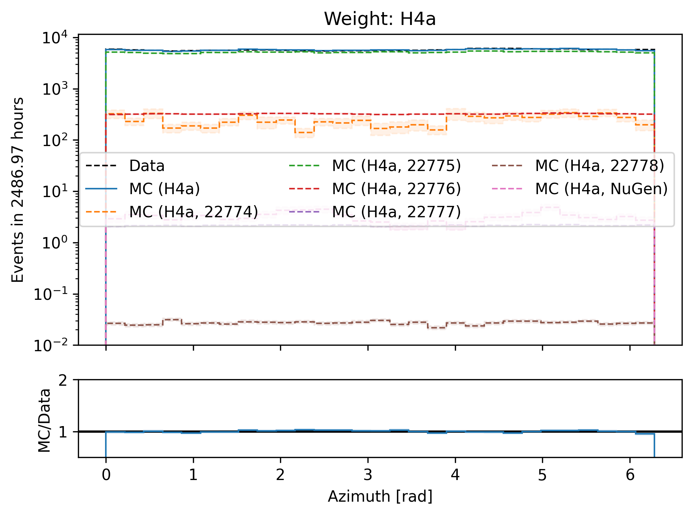
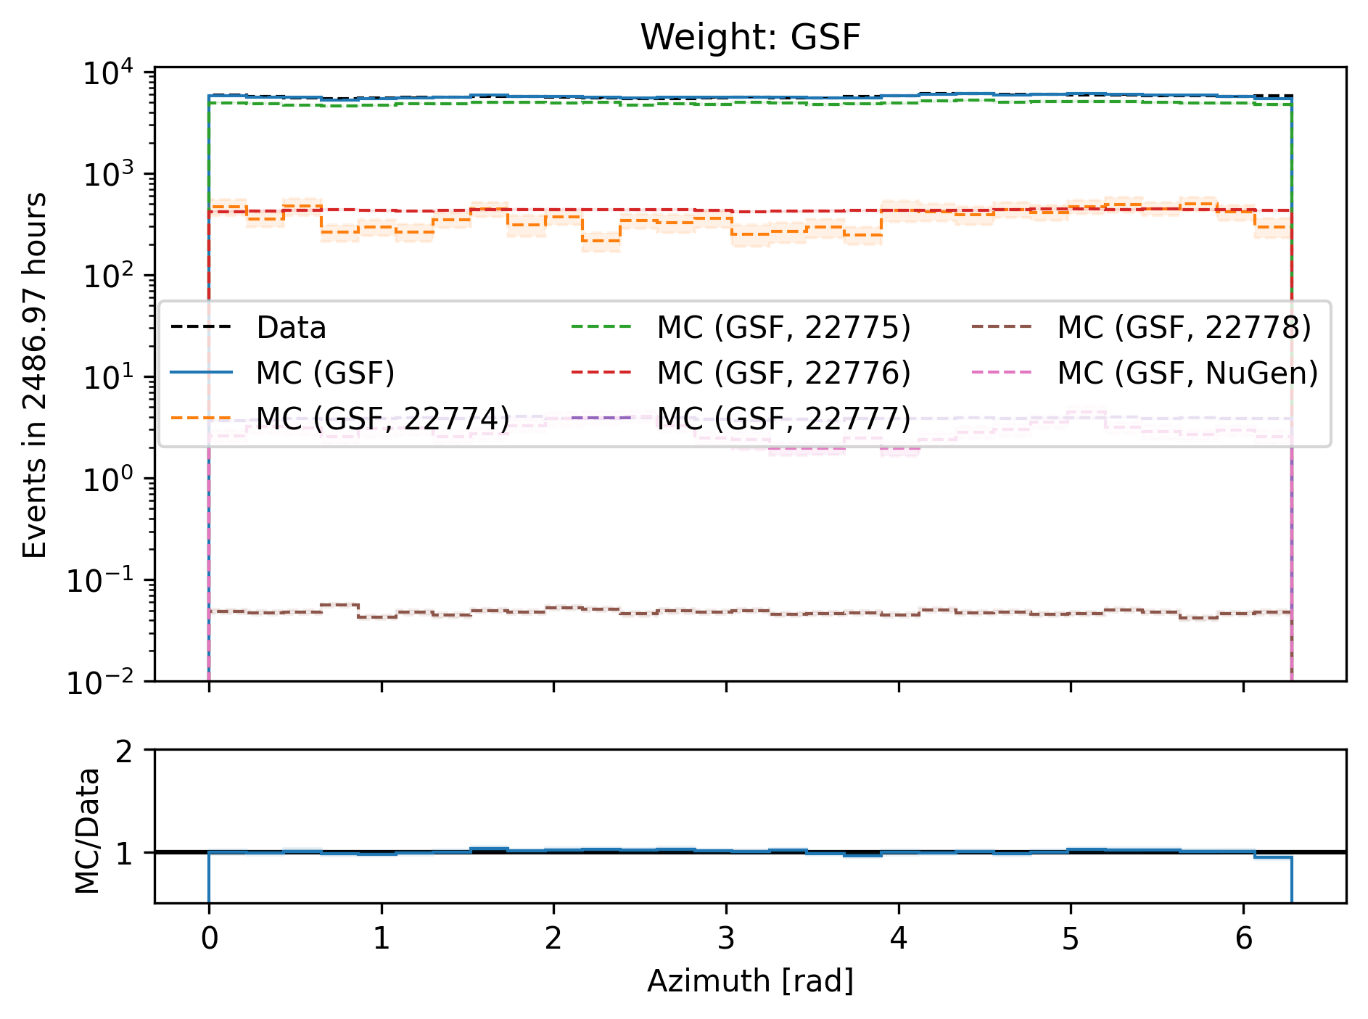
Azimuth

Slide 32
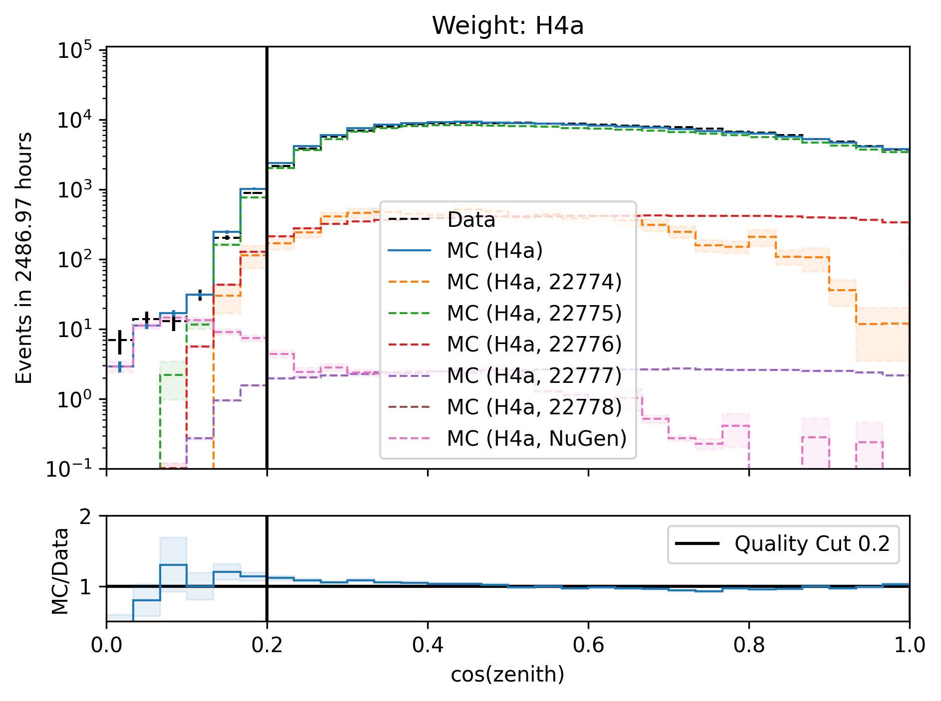
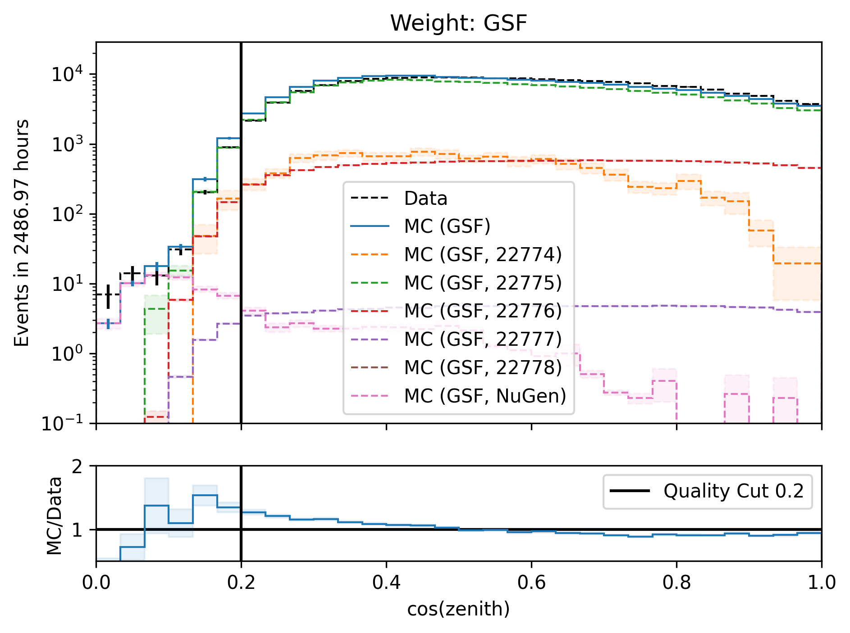
Cos(zenith)

Slide 33
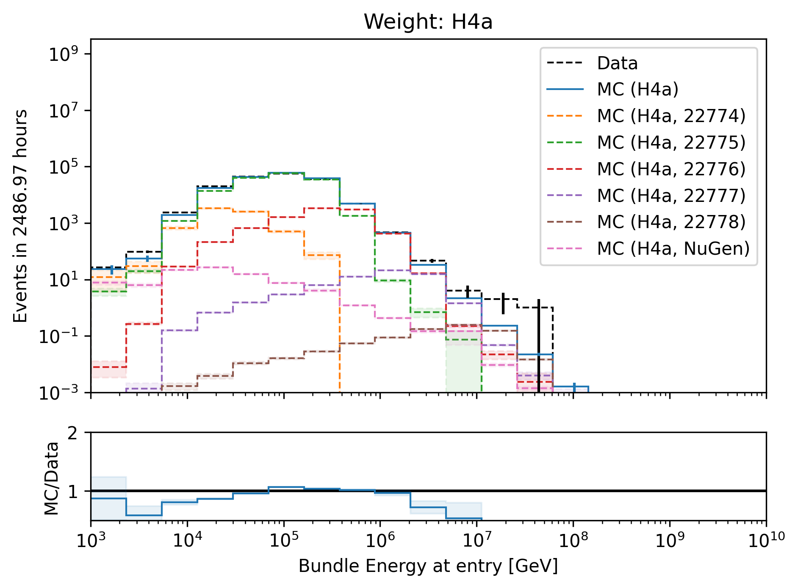
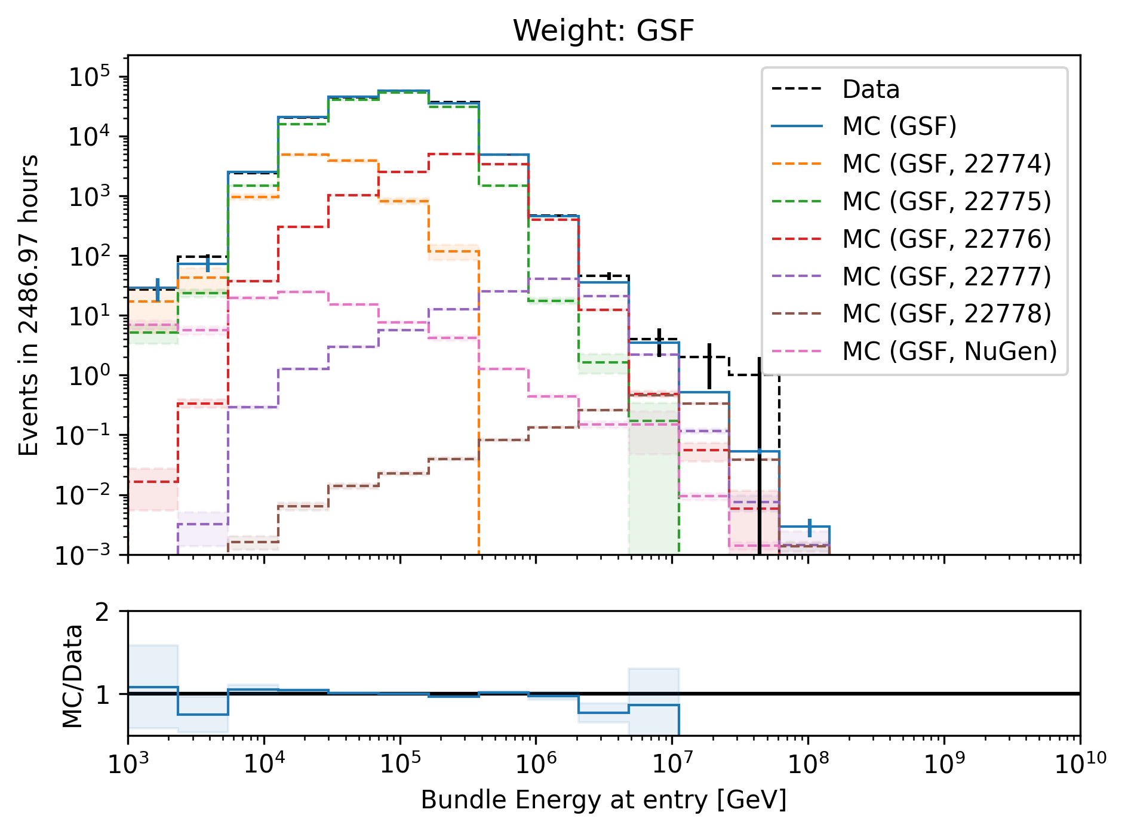
Bundle energy at entry

Slide 34
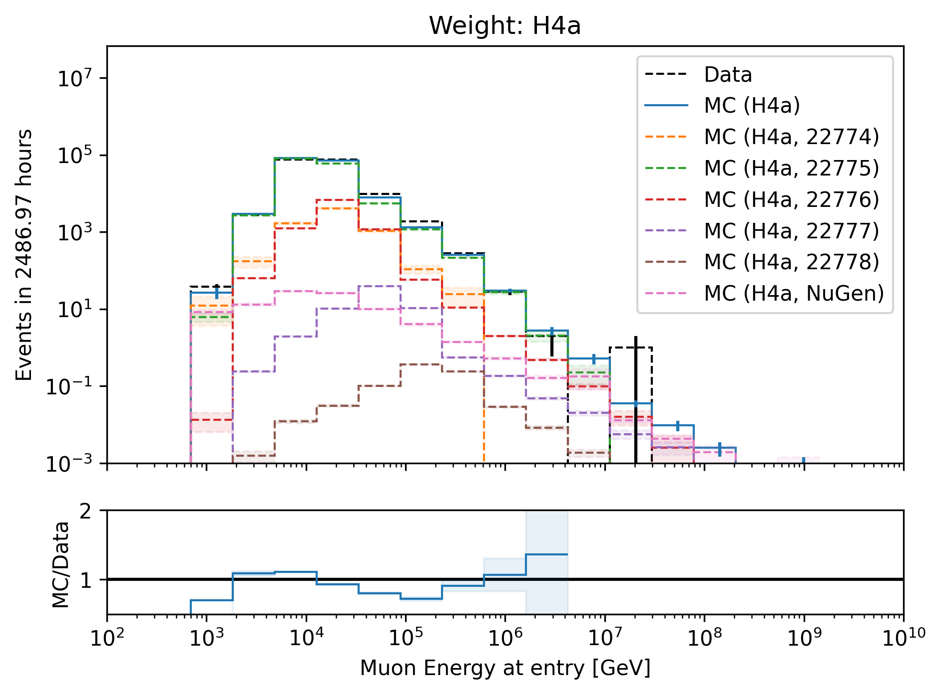
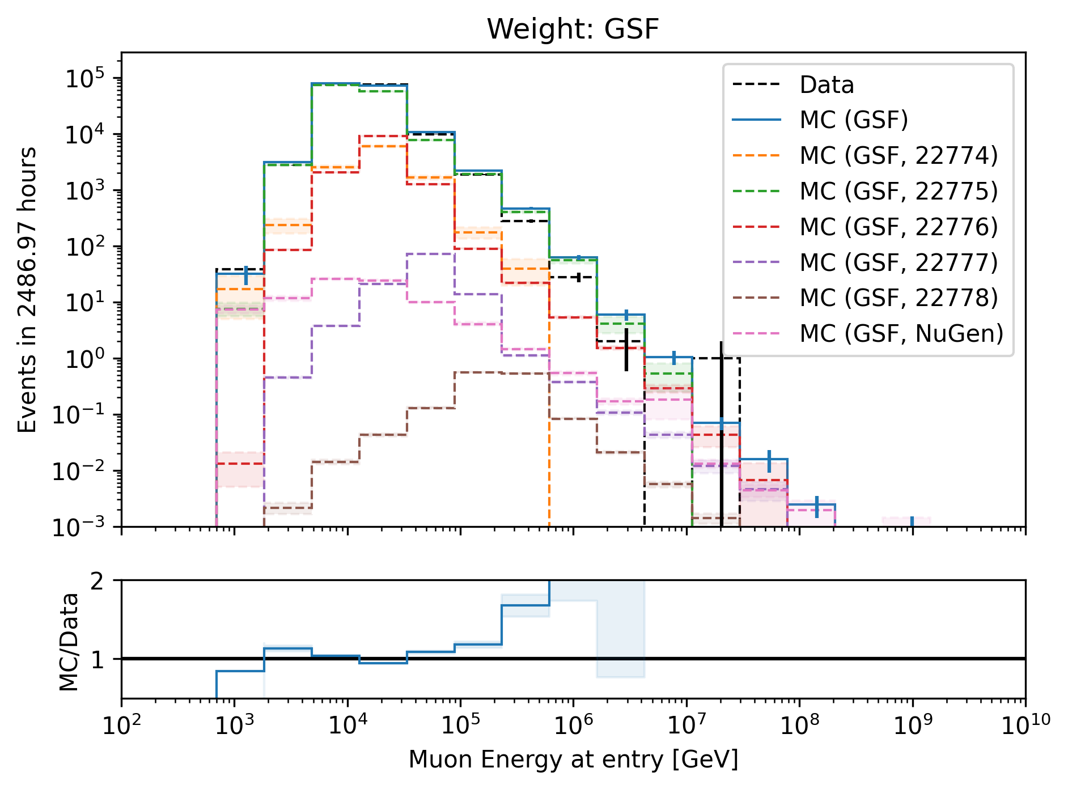
Leading muon energy at entry

Slide 35
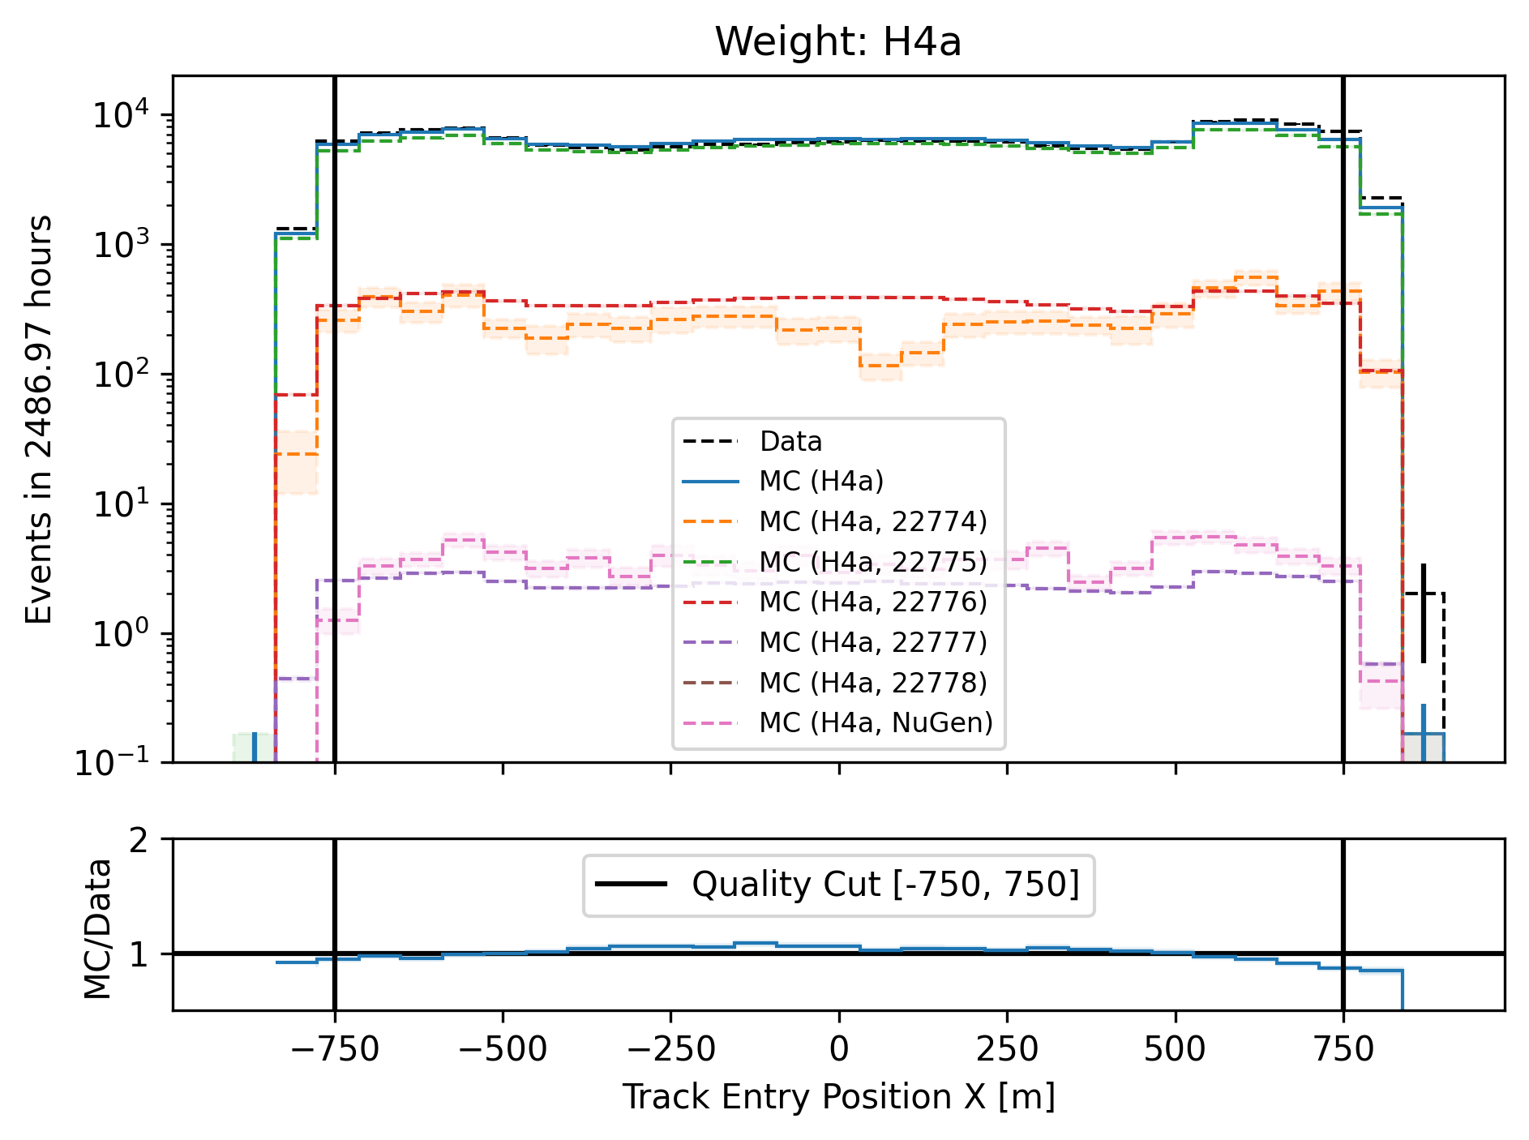
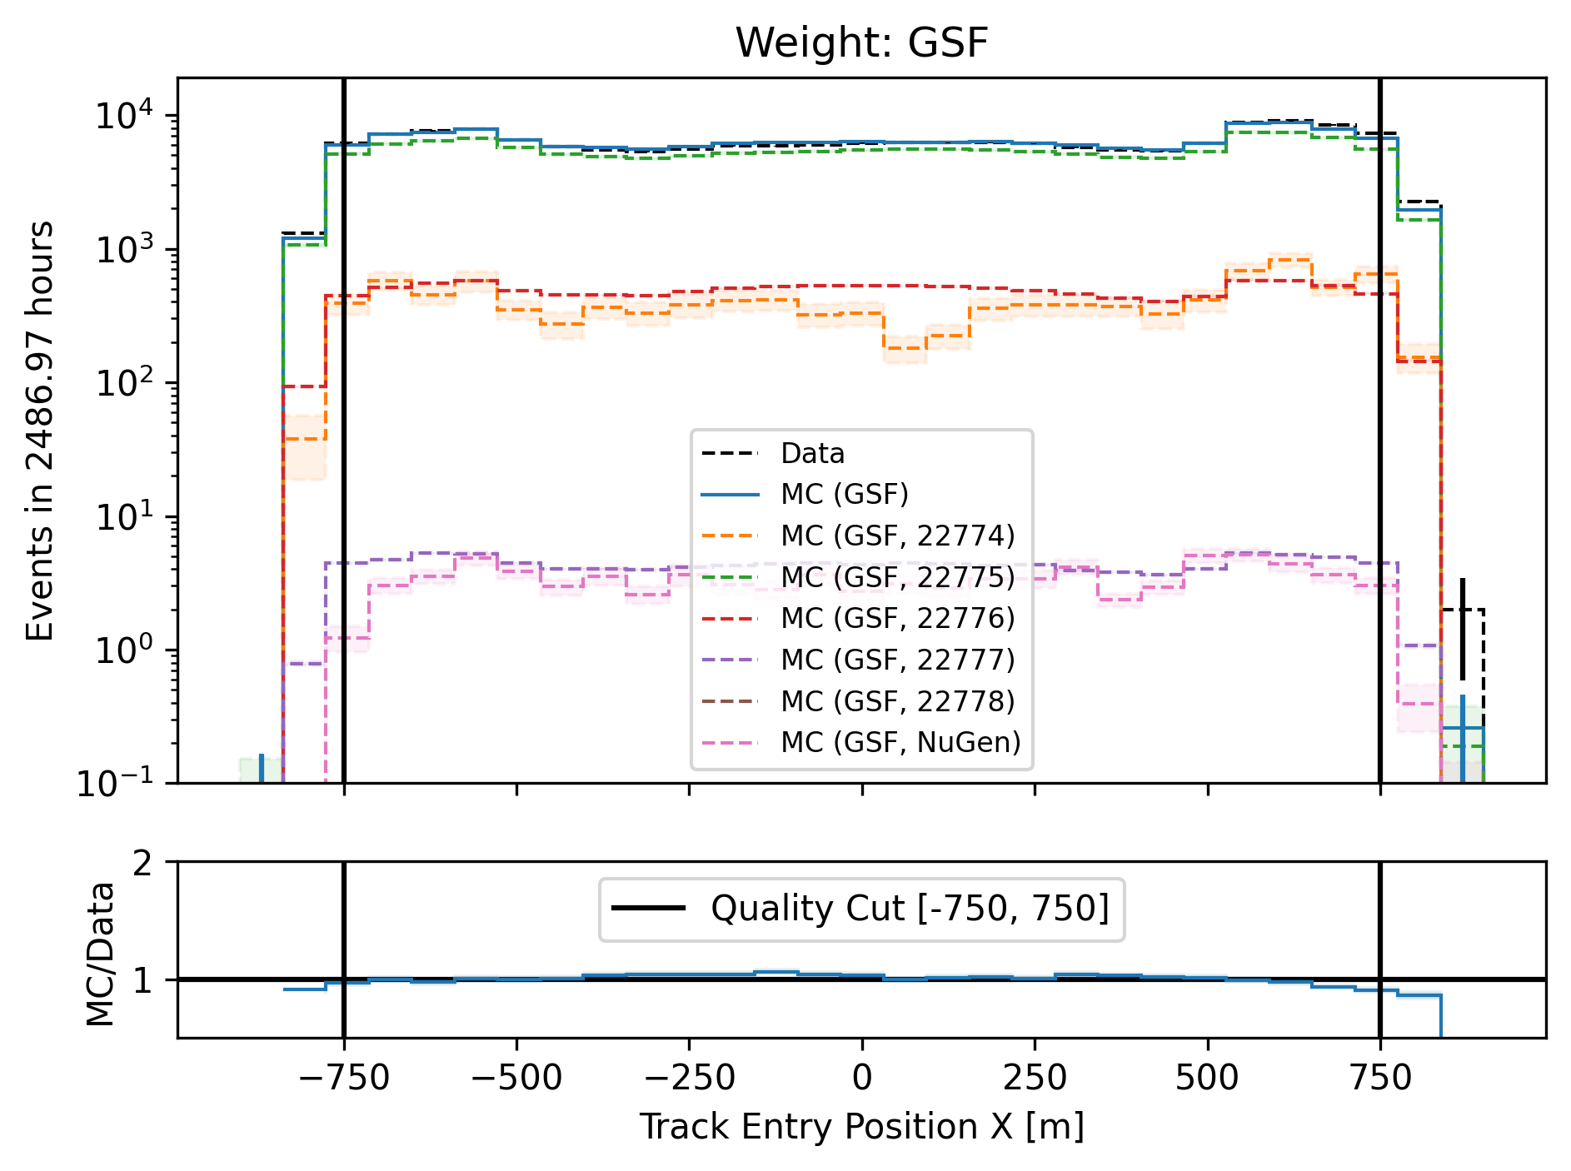
Entry position x–vertex

Slide 36
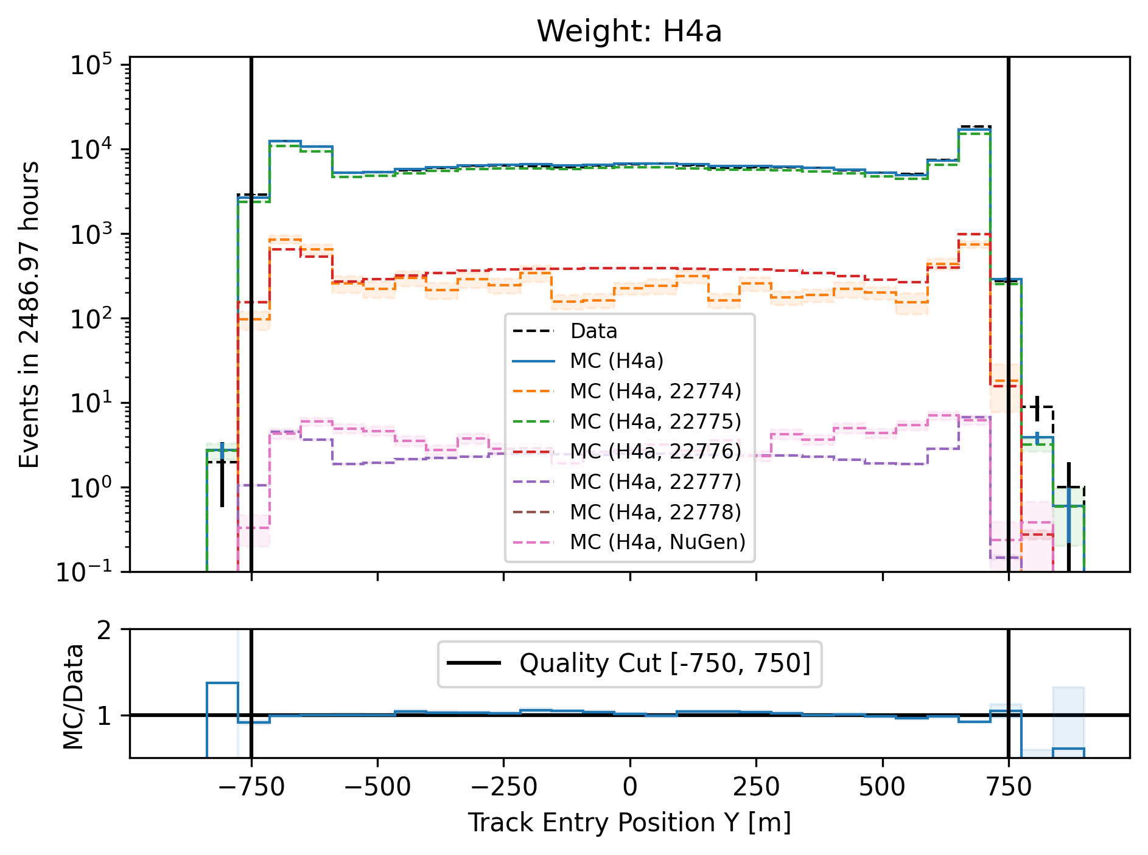
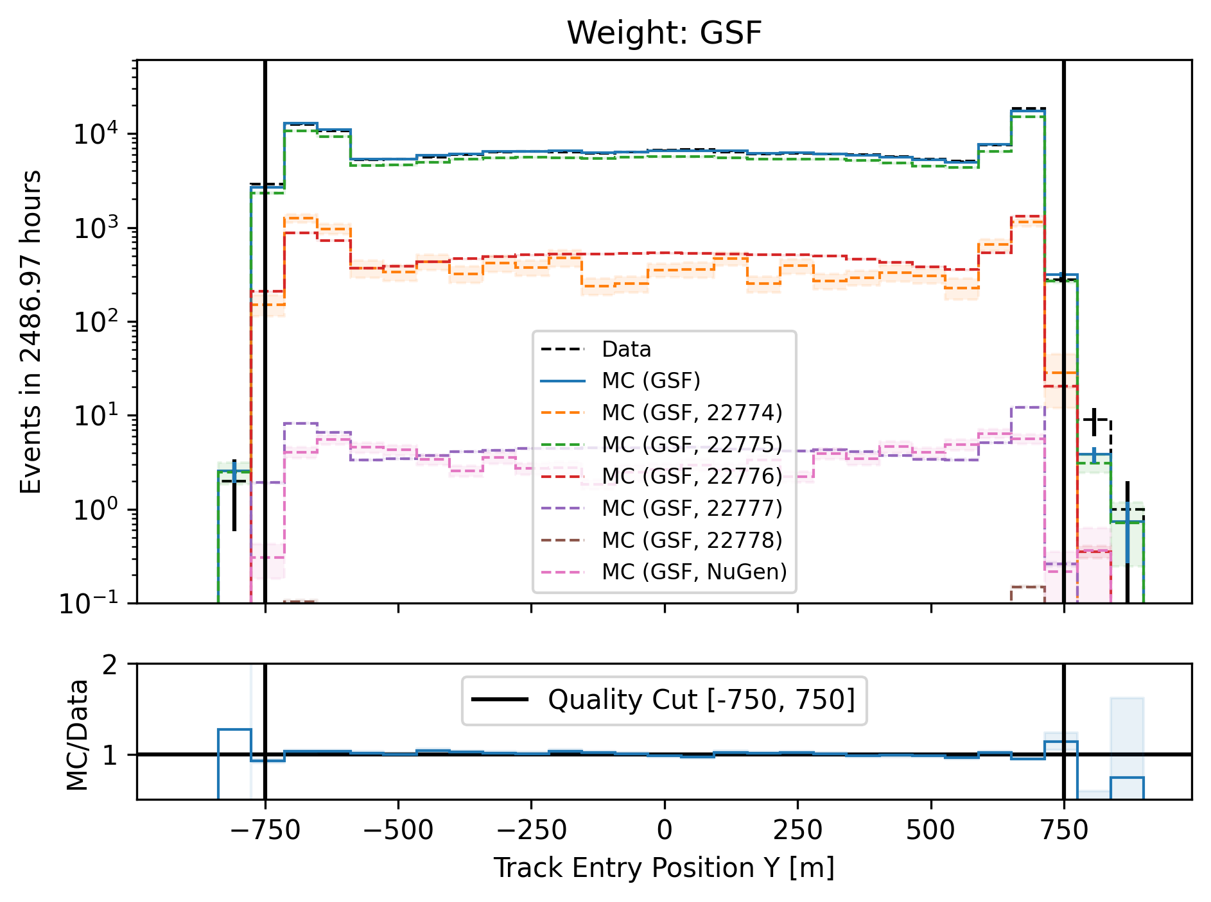
Entry position y–vertex

Slide 37
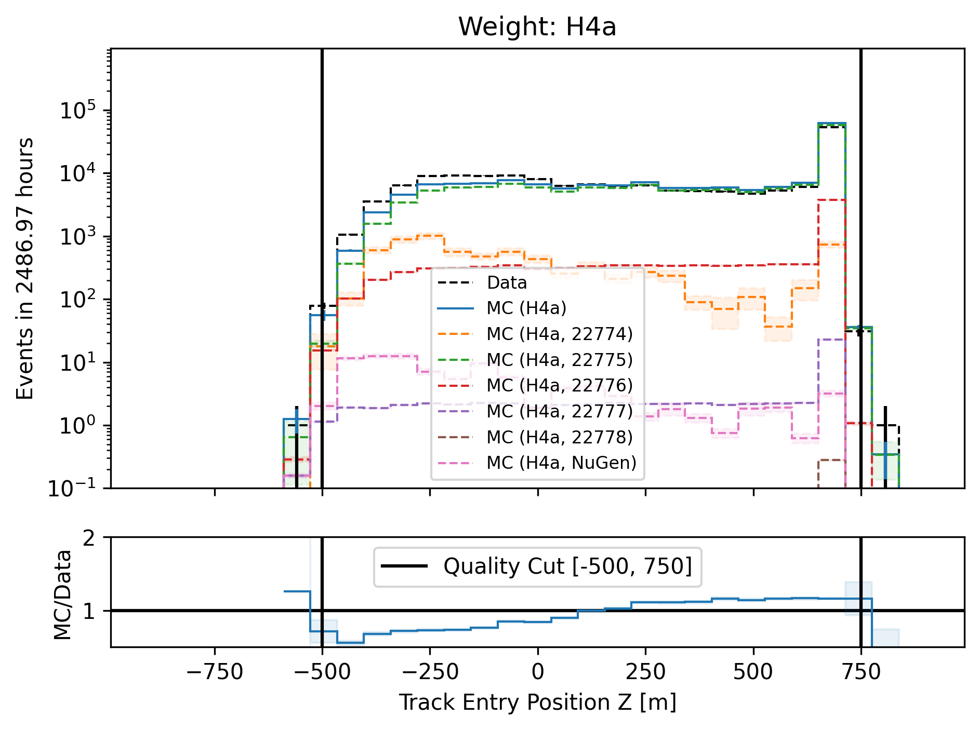
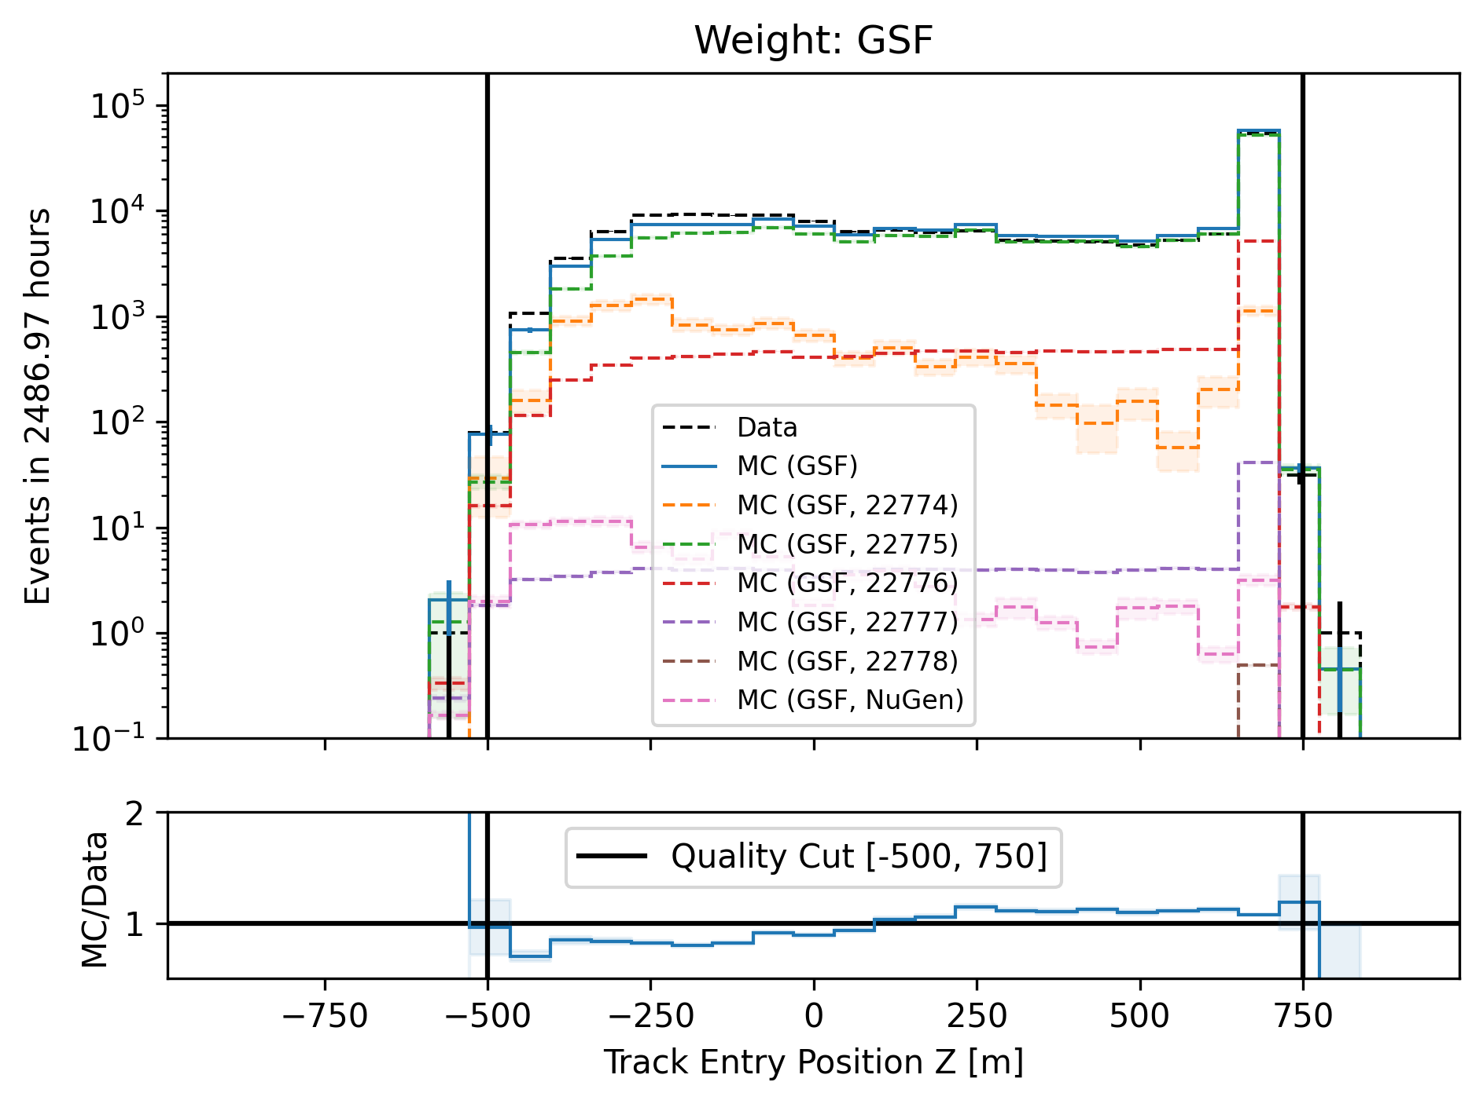
Entry position z—vertex

Slide 38
Level5: quality cuts
show table/list with all quality cuts
example | > | <
length | 1000m | 15000m

Slide 39
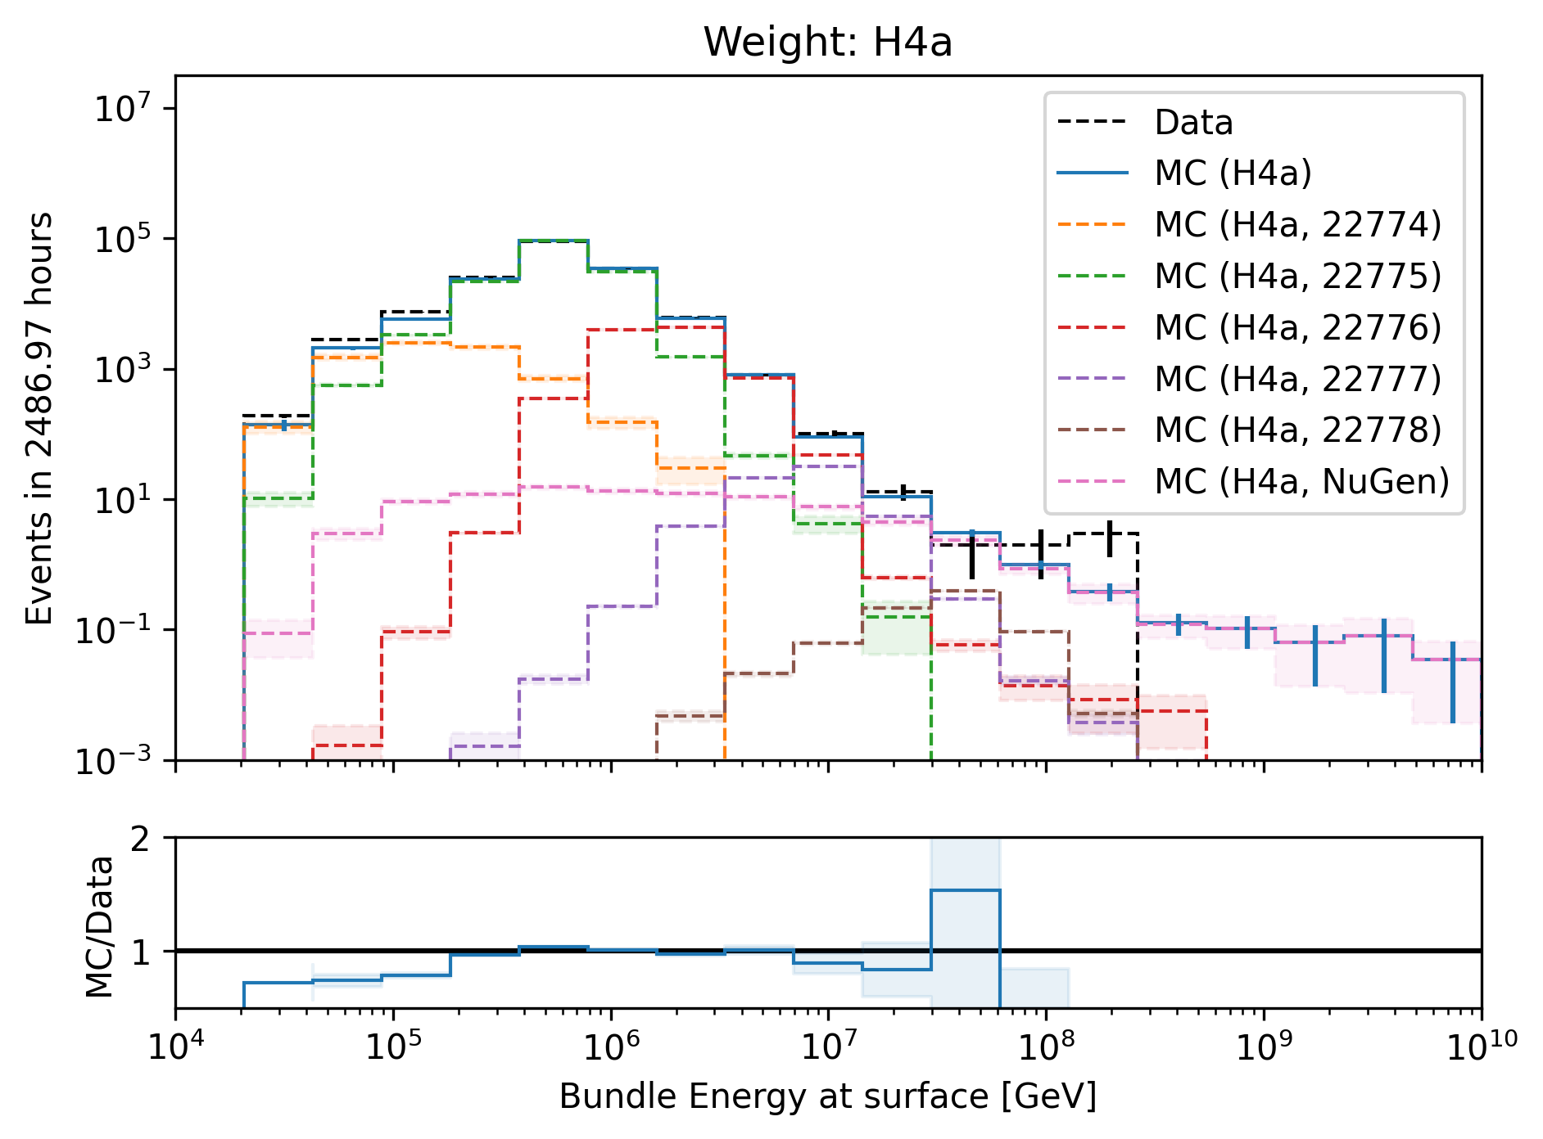
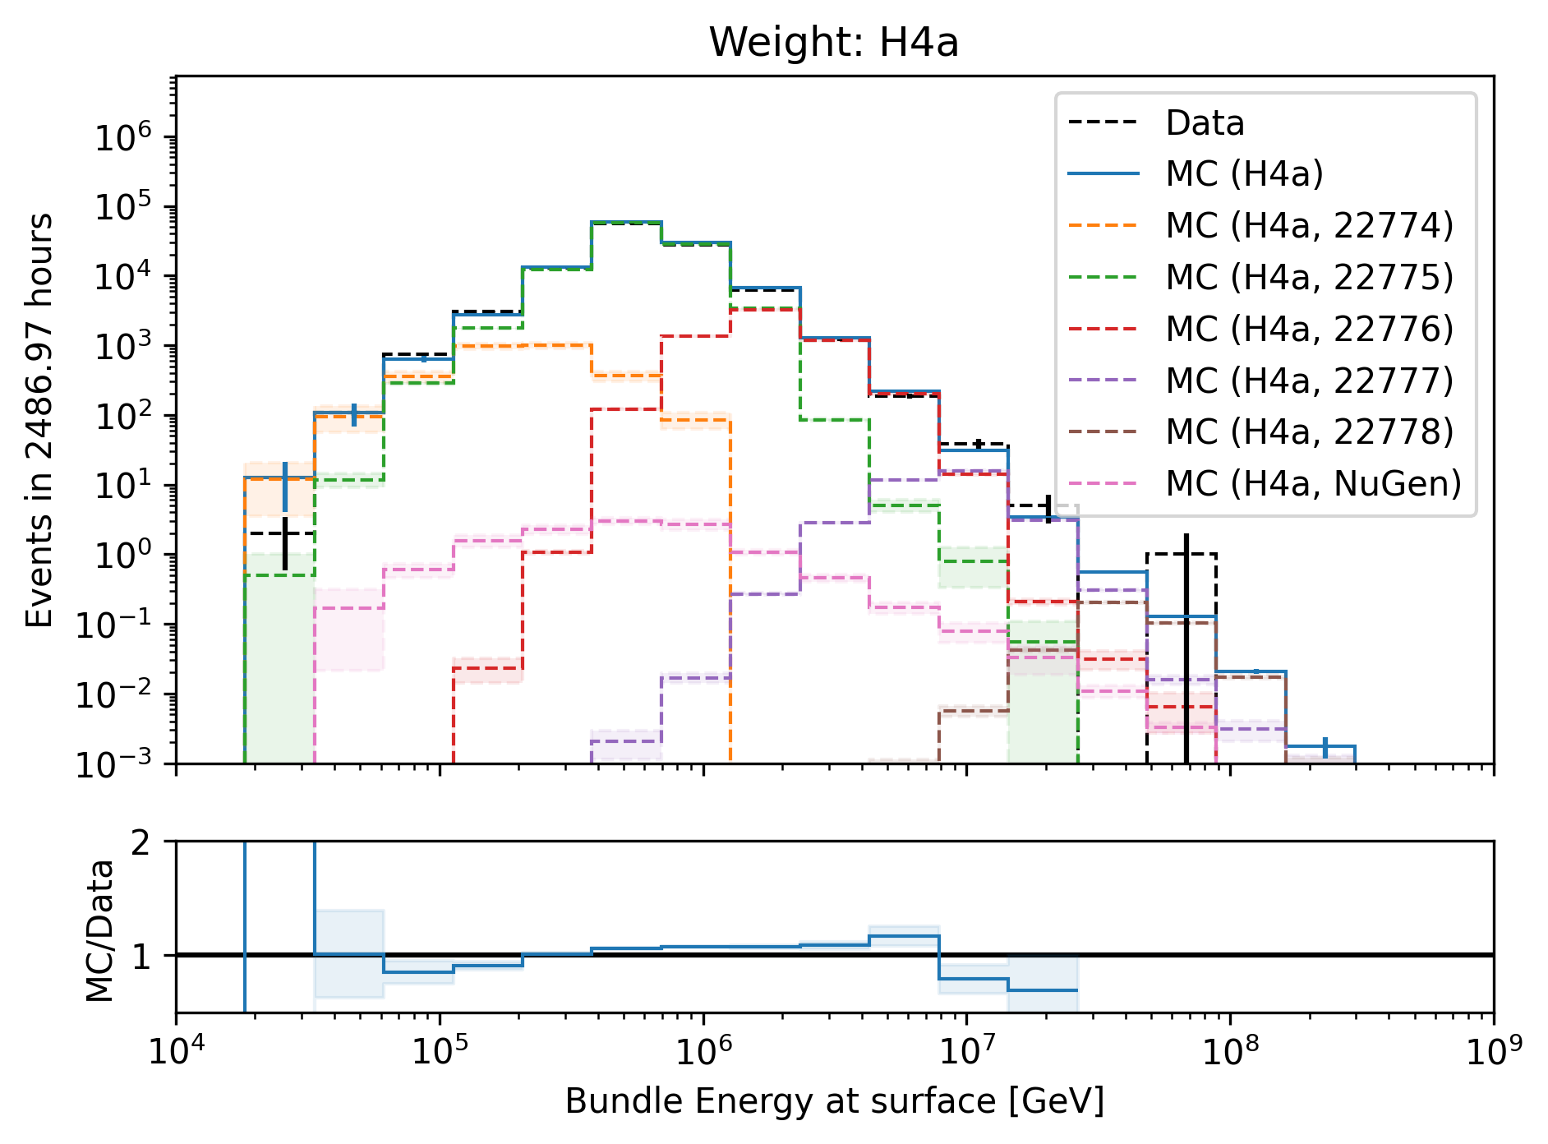
Level5: quality cuts → removes neutrinos

Slide 40
Forward fit

Slide 41
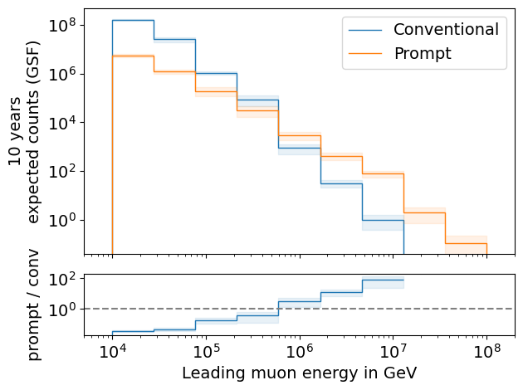
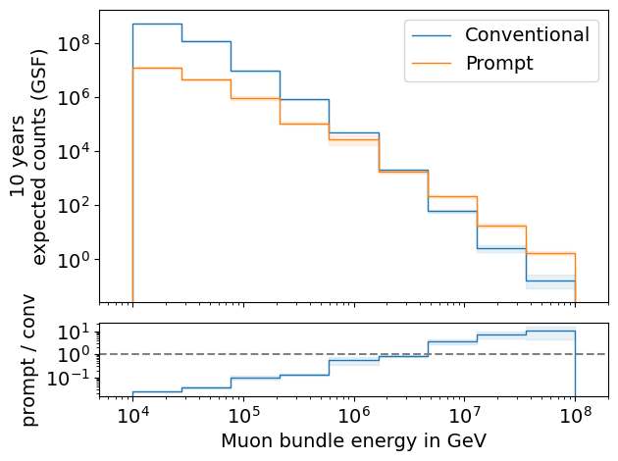
Expected muons for 10 years: leading vs. bundle energy (GSF)
leading: energy of most energetic muon in a muon bundle
bundle: sum of energies of all muons of the bundle
L2 MuonFilter
L2 MuonFilter
Both leading and bundle energy are sensitive to detect prompt
Leading muon energy is more sensitive

Slide 42
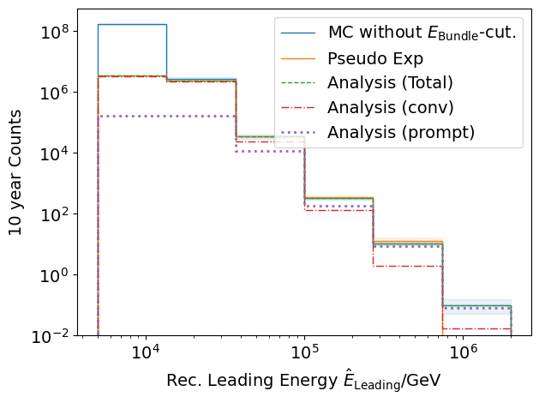
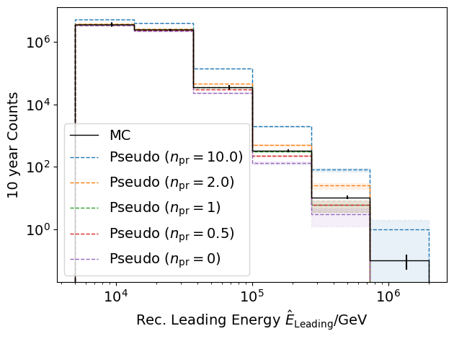
Pseudo data sampling
Cuts:
L2 MuonFilter
Bundle energy > 100 TeV
Tagging allows scaling of prompt by factor n_{pr}

Slide 43
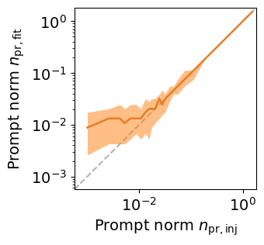
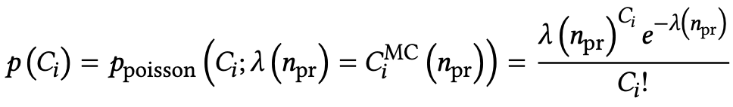
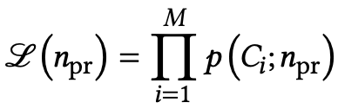
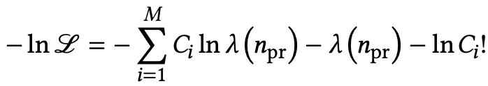
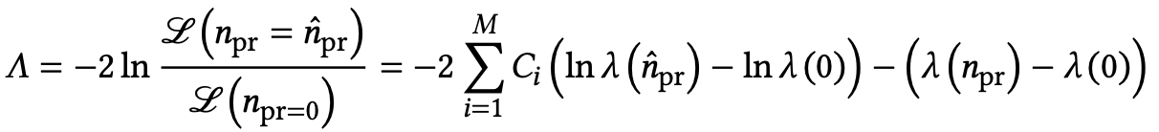
Poisson likelihood fit performed in leading muon energy
Cuts:
L2 MuonFilter
Bundle energy > 100 TeV
Test bias
Prompt scaling/normalization
MC counts per bin i
Conv norm = 1
Experimental counts
Maximize likelihood
With a constant conv norm:
bin counts depend only on prompt norm
= expectation value per bin
Easier:
minimize negative
log-likelihood
Test statistic for Wilks’ theorem
Bias starts at a prompt normalization of 0.1
Null hypothesis: no prompt

Slide 44
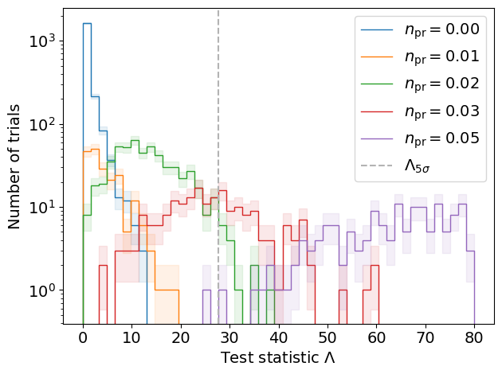
Discovery potential and sensitivity
Cuts:
L2 MuonFilter
Bundle energy > 100 TeV
Expectation for 1 year:
5 sigma discovery potential: 0.102 ± 0.005
Sensitivity: 0.024 ± 0.001
Expectation for 10 years:
5 sigma discovery potential: 0.032 ± 0.001
Sensitivity: 0.007 ± 0.000
Caution:
Limited MC statistics -> events are oversampled in pseudo dataset
No systematic uncertainties

Slide 45
Unfolding

Slide 46
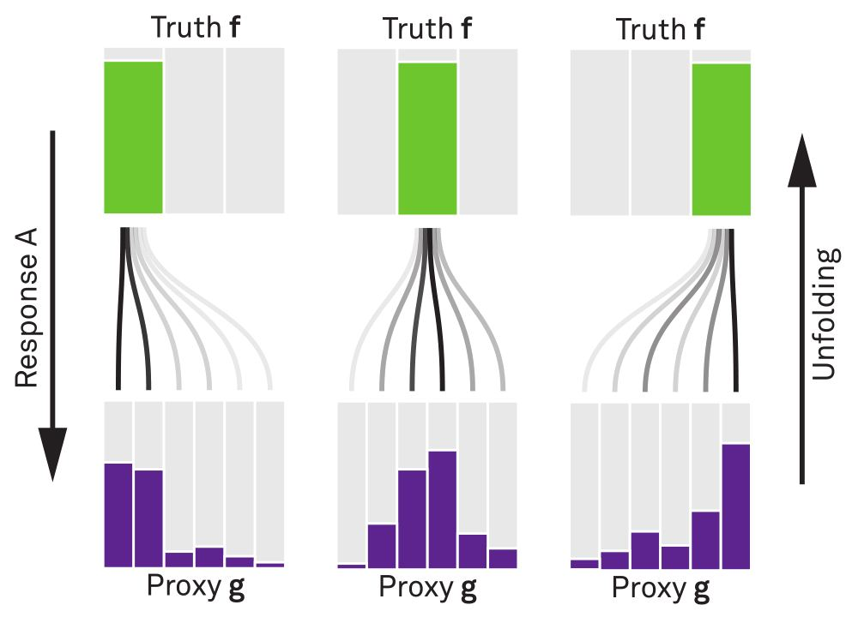








Unfolding in a nutshell
folding
unfolding
1. discretized form: $\vec{g}=A\vec{f}↔\vec{f}=A^{−1}\vec{g}$
measured proxy
detector response
background
$$g\left(y\right)= \int_{E0}^{E1}{A\left(Eµ , y\right)f\left(Eµ\right) dEµ+b\left(y\right) }$$
2. maximum likelihod method:
$$ℒ\left(\vec{g} | \vec{f}\right)=\prod_{j=1}^{M}{\frac{λ_{j}^{g_{j}}}{g_{j}!}exp⁡(−λ_{j})}$$
3. Thikonov regularization:
$$t\left(\vec{f}\right)=−\frac{1}{2}{\left(C\vec{f}\right)}^{T}{\left(τ1\right)}^{−1}(C\vec{f})$$
true energy distribution
$$=\prod_{j=1}^{M}{\frac{{(A\vec{f})}_{j}^{g_{j}}}{g_{j}!}exp⁡(−{(A\vec{f})}_{j})}$$
funfolding
by M. Börner
4. maximize $log⁡(ℒ\left(\vec{g} | \vec{f}\right))+t\left(\vec{f}\right)$
with respect to $\vec{f}$ using
Markov Chain Monte Carlo (MCMC)
Credit: T. Hoinka

Slide 47


Unfolding event rate
1 year
10 years

Slide 48
show / calculate effective area

Slide 49


unfolding of muon flux at surface
1 year
10 years

Slide 50


unfolding of muon flux at surface – weighted to E^(3.7)
1 year
10 years

Slide 51
unfolding with systematics

Slide 52
Conclusion & outlook

Slide 53
Backup

Slide 54

Leading muon energy fraction
Solid: conventional
Dashed: prompt
Prompt dominates for energies > 1 PeV
Leading energy sweet spot: 0.1 – 0.9

Slide 55


Leading muon contribution
Patrick Berghaus
Muons with energies between 100 TeV and 50 PeV dominate the bundle by more than 90%
In average conventional muons are more dominant than prompt
But: at high energies, there are more prompt than conventional events
High leading energy fraction does not lead to more sensitivity to detect prompt

Slide 56

The Muon Puzzle
”muon number”
2108.08341

Slide 57

Possible Solutions
Hans Dembinski

Slide 58
add plot with angular resolution DNN vs. SplineMPE and also duration plot

Slide 59
add z-position mismatch plots

Slide 60

Simulation w/o coincident events
for primary energies above 1 TeV, using a time window of 6 µs, the chance for a coincident event is ≤ 1 %

Slide 61
Bundle energy cut
Rate after muon filter: 24.62 Hz
If the process of 1 event needs 1 second, 8h run takes 200h -> needs to be reduced!
Use small, fast network to remove low energy events -> target rate 125 mHz
CPU runtime: 11 ± 1ms
GPU
Network: precut_surface_bundle_energy_3inputs_6ms_01

Slide 62
Leading muon energy fraction - leadingness
True muon energy fraction is smeared
Network tries to predict the median of the distribution

Slide 63
Zenith – 6 ms cleaned pulses
Median + 90% quantile
Prediction
True

Slide 64
Azimuth – 6 ms cleaned pulses
Median + 90% quantile
Prediction
True

Slide 65
SplineMPE – DNN and conventional seeds
SplitInIceDSTPulsesTWCleaning6000ns

Slide 66
SplineMPE – DNN seeds
SplitInIceDSTPulsesTWCleaning6000ns
DNN contours

